Slide 1
Maintaining and Upgrading Land Mobile Radio Systems
[Name of Presenter]
[Title/Office]
[Date]
Notes:
Stakeholders introduce themselves and state the objective:
The objective of this presentation is to provide you (state and local decision-makers) with an overview of our public safety radio system, factors affecting our system, and our current needs.

Slide 2
Understanding Land Mobile Radio Systems
Radio systems are the primary means of communications for public safety personnel.
These systems are specially designed to meet mission critical needs, to ensure communication in all conditions (e.g., fires, tornados), and to provide high levels of clarity, reliability, coverage, and back-up, in case of emergency.
Notes:
First, just so we have a mutual understanding of what we’re talking about, here’s a quick overview:
Public Safety agencies need secure and reliable communications systems to carry out day-to-day operations and response operations
Public safety agencies and responders use radios as their primary means of communications
Public safety agencies typically have large systems – Land Mobile Radio (or LMR) Systems – that allow public safety agencies and responders to communicate from the base station to responders, and between responders (in vehicles or on foot)
LMR Systems typically consist of handheld portable radios, mobile radios, base stations, and repeaters
Handheld portable radios are typically carried by public safety personnel and tend to have a limited transmission range
Mobile radios are often located in vehicles and use the vehicle’s power supply and a larger antenna, providing a greater transmission range than handheld portable radios.
Base station radios are located in fixed positions, such as public service access points or dispatch centers, and tend to have the most powerful transmitters.
A network is required to connect the different base stations to the same communications system.
Repeaters are used to increase the effective communications range of handheld portable radios, mobile radios, and base station radios by retransmitting received radio signals.
Over the last 50 years, public safety agencies have invested millions of dollars in LMR systems to ensure responders can talk to one another, and to other local, state, and federal officials when needed, and to improve emergency communications:
States have strategic plans in place (Statewide Communication Interoperability Plan- SCIP) to improve emergency communications
Public safety agencies have built tremendous infrastructure and developed response procedures and agreements (MOUs, SOPs, mutual aid agreements) to improve interoperability, and address needs in the SCIP, using LMR systems, equipment, and devices
Since 9/11, public safety agencies have focused on improving interoperability between separate and disparate systems, to ensure responders in one agency, (or one jurisdiction) can talk to responders in another agency (or another jurisdiction), during day-to-day emergencies and large-scale disasters. Millions of dollars in grant funds were distributed to enhance interoperability (Public Safety Interoperable Communications- PSIC grant).
Basically, there is an entire infrastructure in place to support local public safety communications, and equipment, policies, and procedures in place to support interoperable communications with other agencies.

Slide 3
Understanding Evolving Technologies
Many states and regions have statewide or regional radio networks they use specifically for public safety purposes.
Some states and regions have computer-based (or IP-based) networks that allow them to connect different agencies and users.
The federal government is in the process of deploying a single, broadband network for public safety users at all levels of government.
Notes:
You should understand that agencies are at different places in terms of communications
Some smaller agencies are still using basic LMR (radio) systems to communicate (e.g., analog systems), that were built for that agency, are not connected to other systems, are not standards-based, so they do not interoperate with other agencies or jurisdictions.
Others may have upgraded their systems to P25 – digital systems that provide more capabilities, and enable interoperability between other P25 systems.
Some have adopted more advanced, computer-based systems that allow them to connect to more agencies, more systems, more users (IP-based network)
In addition to that, the federal government is moving forward on a plan to deploy a single nationwide BROADBAND network for public safety users, at all levels of government, which leverages an entirely different technology (LTE) that is not interoperable with current LMR infrastructure and devices, this system will just be used for data at first, not mission critical voice.
Until this broadband system is developed by the First Responder Network Authority- FirstNet, public safety is using commercial broadband for public safety data.
So basically, within a given state, there could be local agencies trying to upgrade an older radio system to P25 – to enable it to connect with other P25 systems in its area. In addition, there could be regional efforts or statewide efforts to move toward IP-based networks that leverage computer-based programs and technologies to connect sites, and to expand networks, coverage, and interoperability. As current upgrades are occurring, states are also engaged in preliminary planning to support the deployment of the federal broadband network.
Some states have developed plans and strategies to manage these transitions. [Indicate whether the state has a plan – SCIP or broadband plan under SLIGP].
So before any funding is given to a state or local public safety agency for communications, it is important to understand where the entity is in terms of its technology.
The next slide conveys where [our State] is…

Slide 4
Current Issues for Consideration
Agencies purchased radio systems to meet their mission (e.g., police, fire); radio systems have provided reliable voice communications for many years
Over time, agencies migrated toward standards-based (P25) radio systems that enabled interoperability between agencies, regardless of vendor
Agencies are now moving toward IP-based (computer-based) systems that enable them to connect systems, sites, agencies, and users
Some agencies are also using commercial broadband services to supplement radio systems, to provide another means to communicate or to access data
This has led some to think public safety agencies can use broadband services (cell phones, tablets, etc.), instead of radios for public safety communications; this is not possible because neither commercial entities nor FirstNet can provide (at this time) the features that public safety gets from its radios
Therefore, to provide responders with the best means of communications available at this time, it is critical that we continue to maintain radio systems
Notes:
As the nation migrates toward broadband technologies, it’s important that you understand what broadband is, what it can do, and what it cannot do (at this point).
Broadband: a wide-bandwidth data transmission, with an ability to simultaneously transport multiple signals and traffic types
Broadband has been used interchangeably to describe:
Wireless networks: the FirstNet LTE mobile data network under development (mobile data) and by current private mobile carriers
Wired Networks: fiber used by the telco/internet providers
High speed internet to the home
The fact is that many public safety agencies already use commercial broadband services to supplement mission critical communications [provide examples of where your state/region is using commercial broadband services]
This has led some to think we could use LTE (FirstNet) for voice communications and in effect, replace current LMR systems
However, this is not possible because voice capabilities will not be immediately available on the nationwide network; at first launch, the nationwide network will enable only data transmissions (e.g., videos, database access, mapping) – not voice
It is expected that the nationwide network will enable secure, reliable voice eventually, but will not offer it at first launch

Slide 5
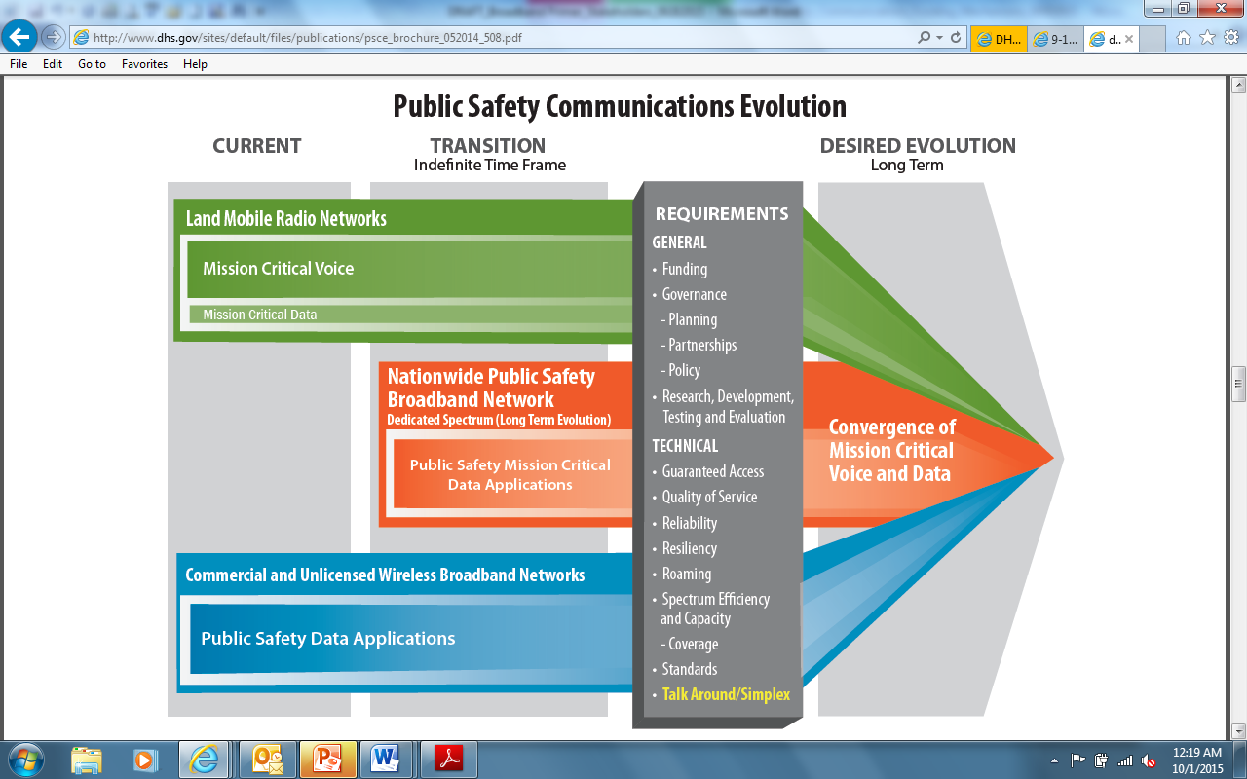
Need to Support Both LMR and LTE
Notes:
Here is a graphic that shows the current situation
The green line shows how current LMR systems are in use now, and will be in use in the long-term
The blue line shows how commercial broadband is occurring in parallel (it is actually moving forward at a very rapid rate)
The orange line represents the development and deployment of the nationwide network, that adopts commercial LTE standards, and will eventually become the centerpiece for public safety communications
There is a critical issue to realize here:
Both LMR and LTE systems will have to be maintained for the long-term (some think it will be indefinitely), to ensure responders have access to secure, mission critical VOICE capabilities. Many agencies are not standing current systems down (or divesting in current LMR systems) until the technology is fully developed, tested, and proven to work. Agencies are choosing instead, to maintain current capabilities using LMR systems, and to plan for the adoption of more advanced technologies (e.g., IP-based technologies, LTE technologies), where they make sense.
Maintaining two systems presents definite funding challenges
Agencies must maintain, upgrade, and sustain current LMR systems as they are planning for the nationwide network
For decision-makers who are asked to fund state and local communications systems, it is critical to understand
Where agencies are in terms of their systems and technologies (age, life cycle, replacement needs)
Where the federal government is in terms of its nationwide network build-out
Where technologies are, in terms of mission critical voice
Understanding where we as a [state, city, region] are in terms of technology will help inform decisions about funding
On the next slides, we will discuss our [state/local] system, issues affecting our system, potential solutions, and funding sources

Slide 6
[Your State’s] Current Communications Systems
Discuss current state of your state/local communications system(s)
Description of system (e.g., statewide system, regional system, local system ) and age
Users (e.g., agencies and # users)
Coverage
Recent Use/Successes
Current challenges
Equipment phased out by vendor
Upgrades needed
System needs to be expanded
Proposal:
Notes:
We have:
Description of system (e.g., statewide, regional, local, ownership, age)
Users (agencies and numbers)
Coverage (can provide areas covered, and include coverage maps in back-up slides)
Most recent success
Issues with the system
Proposal (e.g., replace current system, upgrade current system, purchase new devices)

Slide 7
Communications Concerns and Needs
Discuss your current concerns/needs:
Spectrum (T-Band, existing users in 700 MHz public safety band)
Interoperability
Upgrades
Operating Costs
Funding
Notes:
This would be the customized slide. The point of this slide is to show how far the state has come – in terms of equipment and in terms of coordination – show how much effort and money has been put into these systems.
Secondly, stress how the activities have improved interoperability, and response
Third, discuss the concerns/needs of the state

Slide 8
Proposal
Proposal: Replace regional system, with state-of-the art P25 system t
Projected Cost:
Capital
Ongoing
Projected Benefits:
Users
Coverage
Cost Savings
Efficiencies
Projected Life Span:
Potential Funding:
Notes:
[This would be the customized slide that is based on the solution of your state/region/locality]

Slide 9
Resources
“LMR Trio”: series of documents to inform decision makers about issues affecting LMR technologies:
“LMR 101, Part I: Educating Decision Makers on LMR Technologies,” includes basic information for use in educating decision-makers about the importance of LMR technologies. The paper includes simple diagrams, terminology, history, and current usage of LMR technologies by public safety agencies.
“LMR for Decision Makers, Part II: Educating Decision Makers on LMR Technology Issues,” provides information about emerging technologies, and the impact such technologies will have on LMR systems as they evolve. Information includes discussion of the LMR-to-LTE transition, and the need to sustain mission critical voice through such transition.
“LMR for Project Managers, Part III: A P25 Primer for Project Managers and Acquisition Managers,” delivers an introduction about standards-based (i.e., Project 25 [P25]) purchasing, and an overview of the P25 standard explaining its importance to public safety interoperability.
The Funding Mechanism Document: Examples of how states are funding communication systems;
Notes:
[This would be the customized slide that is based on the solution of your state/region/locality]

Slide 10
Contacts
State Contacts
[INSERT NAME]
[INSERT TITLE]

Slide 11
Additional Slides

Slide 12
Clarification on Broadband
What is Broadband?
Broadband commonly refers to high-speed Internet access, via wireless or wired connection, that are always on and faster than traditional dial-up
Broadband has been used interchangeably to describe:
High speed internet to the home
Wired and wireless services provided by telco/internet providers (commercial services – cable, cell phones, aircards)
People like broadband because it allows them to access and send more information (e.g., pictures, videos) quickly over electronic devices
How is Broadband Used by Public Safety?
Many public safety agencies use commercial broadband services (e.g., cell phones, air cards) to supplement radio communications, but service is subject to the same vulnerabilities that affect personal cell phones (e.g., service overwhelmed during emergencies, lack of coverage, poor voice quality)
While broadband does not provide the same reliability as public safety radios (at this point), it is still useful in that it provides public safety users access to additional information (e.g., databases, social media) that can aid in response
Notes:
As the nation migrates toward broadband technologies, it’s important that you understand what broadband is, what it can do, and what it cannot do (at this point).
Broadband: a wide-bandwidth data transmission, with an ability to simultaneously transport multiple signals and traffic types
Broadband has been used interchangeably to describe:
Wireless networks: the FirstNet LTE mobile data network under development (mobile data) and by current private mobile carriers
Wired Networks: fiber used by the telco/internet providers
High speed internet to the home
The fact is that many public safety agencies already use commercial broadband services to supplement mission critical communications [provide examples of where your state/region is using commercial broadband services]
This has led some to think we could use LTE (FirstNet) for voice communications and in effect, replace current LMR systems
However, this is not possible because voice capabilities will not be immediately available on the nationwide network; at first launch, the nationwide network will enable only data transmissions (e.g., videos, database access, mapping) – not voice
It is expected that the nationwide network will enable secure, reliable voice eventually, but will not offer it at first launch

Slide 13
Nationwide Public Safety Broadband Network
What is the Nationwide Public Safety Broadband Network?
The NPSBN is intended to provide a single platform for public safety users and officials at all levels of government, to communicate and interoperate
The First Responder Network Authority (FirstNet) is assigned to manage the NPSBN, and is in the process of issuing an RFP for the build-out
How Will FirstNet Benefit Public Safety?
The NPSBN will provide public safety users, with greater access to data (e.g., databases, video camera feeds), and enhanced capabilities (e.g., NG911)
The deployment of a nationwide network will help move agencies, at all levels of government, toward one standard (LTE), which will enable interoperability, support a coordinated response, and achieve cost efficiencies
In 2012, Congress passed legislation supporting the development and deployment of a single, nationwide public safety broadband network (NPSBN)
Notes:
The Nationwide Public Safety Broadband Network (NPSBN) was authorized by Congress in 2012
The goal was to establish a single platform where public safety agencies at all levels of government could communicate, interoperate
Spectrum was set aside to build a dedicated network, just for public safety use
The network is designed to provide public safety with greater access to advanced technologies, data, video – and for all agencies to be able to interoperate when needed

Slide 14
Current Communications (Before NPSBN)
Currently, public safety personnel leverage state/local/regional LMR networks for mission critical voice during day-to-day operations and response
Public safety also leverages commercial services for voice and data to enhance communications, which are useful, but subject to the same vulnerabilities as personal cell phones (e.g., overload during emergencies, dropped calls)
Source: www.firstnet.gov/network/lmr
Notes:
Currently, public safety personnel leverage state and local LMR networks for mission critical voice – this is the most reliable means of communications for responders
Public safety also leverages commercial services (voice and data), which are useful, in that they allow first responders to access data, and other forms of information (e.g., video feeds, social media) that can help to inform the response, but these services are subject to the same vulnerabilities as personal cell phones (e.g., overload during emergency, dropped calls, spotty coverage, poor voice quality). These services are useful to public safety, but are not reliable enough for lifesaving tasks – for those, public safety uses LMR mission critical voice.
So now, public safety agencies are using state and local LMR systems, and commercial services to communicate

Slide 15
Communications After NPSBN (First Launch)
At first launch, FirstNet will provide high‐speed data, video, and some voice capabilities; but NOT mission critical voice capabilities
Public safety agencies will need to continue to leverage state and local LMR systems to provide first responders access to mission critical voice
Source: www.firstnet.gov/network/lmr
Notes:
At first launch, FirstNet will provide high‐speed data, video, and voice; but NOT mission critical voice capabilities.
Per FirstNet - The immediate goal is to provide a broadband network to carry data; although it will likely provide an option for voice communications, mission critical voice (which require higher levels of quality of service) will not be available at first launch.
This is due in part to the fact that, at present, there is no tested technology to deliver voice communications over LTE broadband that meets first responder requirements (Congressional Research Service, 2015)
Therefore, public safety agencies will need to continue to use state and local LMR systems for mission critical voice, and fund state and local LMR systems to ensure first responders have access to mission critical voice

Slide 16
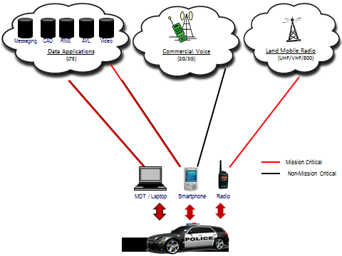
NPSBN – Issues for Awareness
FirstNet will not offer mission critical voice capabilities from the outset
State and local agencies will need to sustain LMR systems to provide mission critical voice to first responders
State and Local
FirstNet
Notes:
Here is another graphic that shows the division of responsibility at the launch of the NPSBN – FirstNet can provide data, while states and locals will continue to operate LMR networks, and any commercial services it needs.

Slide 17
NPSBN – Issues for Awareness
The Federal government has advised states to continue to invest in and maintain LMR networks because:
Mission critical voice capabilities will not be available at first launch.
The immediate goal for FirstNet is to provide a broadband network to carry data. Mission critical voice communications which require higher levels of quality of service, will be available ONLY over LMR networks.
Timelines related to the NPSBN are uncertain at this time.
The requirements of the Spectrum Act and the viability of the project must be met by 2022 (i.e., the network must be in operation by 2022); but deadlines for building the network have no required deadline (i.e., the contract processes, the state-by-state build-out do not have set deadlines).
The timeline for when mission critical voice will be available is uncertain.
At present, there is no tested technology to deliver voice communications over LTE broadband that meets first responder requirements.
Notes:
This slide depicts the major issues affecting the build out of the NPSBN…
Overall timelines affecting the NPSBN – the RFP has not yet been issued – there are no required deadlines for interim activities; the only requirements in terms of time is that the network must be in operation by 2022 – this does not provide any guidance on when FirstNet will be available in any given state
Requirements and standards for mission critical voice over LTE are still under development.
FirstNet is launching data only to start – mission critical voice will not be offered at first launch
Therefore, the federal government has advised state and locals to sustain current LMR systems (because of all the uncertainty around FirstNet)

Slide 18
NPSBN – Issues for Awareness
The Federal government has advised states to continue to invest in and maintain LMR networks to ensure first responders can communicate with each other and with relevant government officials.
The immediate goal for FirstNet is to provide a broadband network to carry data….Mission critical voice communications, which require higher levels of quality of service, will, in most states, be available only over LMR networks operating….under the jurisdictions of state and local public safety agencies. States will likely need to continue to invest in and maintain their [LMR] networks. (Congressional Research Service, May 2015)
When FirstNet launches the NPSBN, the network will initially provide mission‐critical, high‐speed data and video services that will supplement today’s LMR networks. The network is also expected to provide non-mission critical voice at launch. Public safety entities will continue to rely on their LMR networks for mission critical voice features needed in an emergency response setting. In the near term, public safety entities will need to maintain and/or upgrade their LMR networks, as appropriate. (FirstNet)
Notes:
The federal government has advised states to continue to invest and maintain LMR networks – this may help to strengthen the case at the state level. This advice has come through FirstNet, DHS, the Congressional Research Service, and major stakeholder groups (SAFECOM).
States should NOT stop investing in LMR until there is a certain and tested LTE solution that is comparable or better than current mission critical voice offered through state and local LMR networks

Slide 19
Responders Trust Radios
RADIOS PROVIDE:
Reliable Voice Capabilities for day-to-day operations and during emergencies
Priority Service - Direct access to public safety communications networks without interference from non-public safety users
Coverage – Radio systems have been expanded over many years to ensure coverage in all areas
Interoperability – Radios provide public safety agencies and officials at all levels of government, to communicate and coordinate response
Rugged devices that are durable and easily used in harsh response environments
While cell phones provide responders with an additional means to communicate, they do not yet offer all the features and functions of radios, that responders need in emergencies
CELL PHONES PROVIDE:
An additional means of communications during day-to-day and emergency events
More data capabilities (e.g., video recording, apps, GPS services) to inform response
CELL PHONES DO NOT PROVIDE:
Guaranteed access to voice capabilities at all times (e.g., dropped calls, no coverage, congestion during heavy use)
Priority Access - public safety users do not have access over non-public safety users
Coverage in all areas
Needed features (e.g., rugged devices, push-to-talk, group talk to enable interoperability)
The Federal government has advised states to continue to invest in and maintain LMR networks to ensure first responders can communicate with each other and with relevant government officials.
The immediate goal for FirstNet is to provide a broadband network to carry data….Mission critical voice communications, which require higher levels of quality of service, will, in most states, be available only over LMR networks operating….under the jurisdictions of state and local public safety agencies. States will likely need to continue to invest in and maintain their [LMR] networks. (Congressional Research Service, May 2015)
When FirstNet launches the NPSBN, the network will initially provide mission‐critical, high‐speed data and video services that will supplement today’s LMR networks. The network is also expected to provide non-mission critical voice at launch. Public safety entities will continue to rely on their LMR networks for mission critical voice features needed in an emergency response setting. In the near term, public safety entities will need to maintain and/or upgrade their LMR networks, as appropriate. (FirstNet)
TEST
NOTICE TO STATE AND LOCAL OFFICIALS
State and local officials should continue to fund public safety radio systems until it is proven that new technologies, systems, and devices can provide responders with the same (or better) capabilities they need to safely respond to emergencies and save lives
Notes:
This slide is intended to illustrate why it is important to continue funding LMR.

