Slide 1
National Public Safety Telecommunications Council Overview
FEMA RECCWG Support and Engagement
March 1, 2016

Slide 2
Welcome and Opening
Ralph Haller
NPSTC Chair

Slide 3
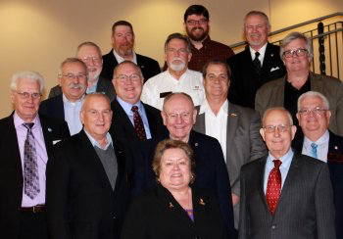
NPSTC Mission Statement
NPSTC is a federation of organizations whose mission is to improve public safety communications and interoperability through collaborative leadership.

Slide 4
NPSTC Governing Board (Voting Member Organizations)

Slide 5
NPSTC Structure
Governing Board
Spectrum Management Committee
Interoperability
Committee
Technology and Broadband
Committee
Each Committee hosts various working groups and task groups
NPSTC Relies on Volunteers

Slide 6
Interoperability Committee
John Lenihan, Chair | Don Root, Vice Chair

Slide 7
Interoperability Committee
Encryption Issues
The Interoperability Committee is reviewing how public safety agencies are using encryption and the impact when encryption is used on interoperability channels.
The input received will be submitted to the NPSTC Governing Board for review and possible adoption of a position statement.

Slide 8
Interoperability Committee
Cross Border Working Group – Steve Mallory, Working Group Chair
Joint working group with the Canadian Interoperability Technology Interest Group (CITIG)
Published a comprehensive report on cross border communications issues and best practices and a report on mobile and portable radio use at the US/Canadian border.
Currently working on:
Report detailing all I/O channels along the border.
Report detailing cross border base station licensing process.
Report on Emergency Vehicle Border Crossing best practices.
Receive presentations from Border Interoperability Demonstration Project Grant (BIDP) agencies

Slide 9
Interoperability Committee
Common Channel Naming Working Group
NPSTC developed a common channel naming document and APCO developed a standard from that document. Channel names were synchronized with the OEC NIFOG.
Currently, the 2012 standard is being updated:
Updated introduction to acknowledge 2014 FCC order
Integrate 700 MHz Air-Ground Channels “AG” (7AG78, 7AG80,7AG85, 7AG88 including “D”)
Reformat Appendix Tables to follow NIMS ICS-217A format
Add 155.1600 as a common-use channel for SAR (VSAR16)
Clarified PL code of 156.7 with allowance for 136.5 for transportable relay stations on the VTAC channels.
The Working Group also completed a best practice naming methodology report for state mutual aid channels.

Slide 10
Interoperability Committee
700 MHz Transportable Trunking Solutions
In partnership with the National Regional Planning Council (NRPC), created a report that identifies implementation issues for use of new FCC designated nationwide channels to support transportable trunking systems:
Common Talkgroup (TG) names including a Calling TG, Command TG, Emergency TG and 13 Tactical TG’s to be assigned by the COML.
Two Zones support flexible operations and use of up to two separate transportable systems.

Slide 11
Interoperability Committee
Radio IO Best Practices Working Group – Mark Schroeder, Chair
This working group studies after action reports following major incidents to identify issues and solutions.
The deaths of 19 wild land firefighters during the Yarnell Hill incident prompted the creation of this working group.
They are developing 13 reports that each detail a best practice statement to enhance public safety communications interoperability.

Slide 12
Interoperability Committee
Radio IO Best Practices Statements (cont:)
BP A: Nationwide I/O Channel Naming and Usage
BP B: Radio Channel Assignment and Use within High Risk Incident Environments
BP C: Recording the Use of Interoperability Channels
BP D: Interoperability Systems Change Management Systems
BP E: Deployment for Interoperability Resources
BP F: Infrastructure Management
BP G: Radio Device Management
BP H: Channel Assignment Based on Infrastructure Coverage
BP I: Communications Span Control
BP J: Training and Proficiency in the Mangement and Usage of I/O Systems
BP K: After Action Reviews
BP L: Interoperability Relationships
BP M: Managing Encryption during Interoperable Events

Slide 13
Spectrum Management Committee
David Buchanan, Chair | Stu Overby, Vice Chair

Slide 14
Spectrum Management Committee
Spectrum Management Committee
4.9 GHz Further Notice of Proposed Rulemaking
T-Band Follow up and Report Refresh
700 MHz Incumbent Relocation to support FirstNet
Project 25 CAP Compliance Standards
Assists other NPSTC working groups regarding identification of spectrum needs to support operations, including UAVs and robots.

Slide 15
Spectrum Management Committee
Interference Protection Working Group
Monitoring proposal and testing by Ligado Networks (formally LightSquared) regarding satellite deployments that may negatively impact public safety GPS.
Monitoring recent FCC waivers to AT&T which allow significantly increased power by cellular carriers using Power Flux Density (PFD); to determine interference risk to public safety agencies.
Monitoring recent reports of interference to officer’s portable radios by body worn cameras, which are causing the radio to lose the control channel and stop working.

Slide 16
Spectrum Management Committee
FCC and Regulatory Filings
The Spectrum Management Committee monitors, reviews and recommends regulatory position statements to the NPSTC Governing Board.
NPSTC regularly files comments with the FCC and other entities, including NTIA and FirstNet.
NPSTC filed 24 sets of comments in 2015.

Slide 17
Filings Completed in 2015 (page 1 of 2)
Date Filed | Topic | Type of Filing
Dec 31 | AT&T Waiver Request – TN & KY | Comments to FCC
Dec. 9 | 700 MHz Incumbent Relocation | Comments to FCC
Nov. 20 | P25 CAP | Ex Parte to FCC
Oct. 16 | 700 MHz Deployable Trunked Report | Ex parte to FCC
Sept. 9 | LightSquared | Ex parte re test plan to FCC
Sept. 9 | 800 MHz band Interstitials | Comments on LMCC protocol
July 29 | LightSquared/GPS | Letter to FCC
July 27 | FirstNet Draft RFP | Comments to FirstNet
July 13 | Interference Dispute Resolution | Comments to FCC
July 6 | Rules on Public Safety Airborne Use | Ex Parte to FCC
July 1 | AT&T Waiver Request - Kansas | Comments to FCC
July 1 | RF Interference from Lighting | Letter/Report to FCC

Slide 18
Filings Completed in 2015 (page 2 of 2)
Date Filed | Topic | Type of Filing
June 19 | Waiver Request-Ultra Wideband | Comments to FCC
June 8 | 800 MHz band Interstitials | Ex Parte to FCC
June 4 | FirstNet Third Notice re PS Definition | Comments to FirstNet
May 28 | TIA Recon re P25 CAP at 700 MHz | Ex Parte to FCC
May 11 | 800 MHz Interstitials | Comments to FCC
April 30 | AT&T Waiver Request - Missouri | Comments to FCC
April 28 | FirstNet Second Notice re Opt-Out | Comments to FirstNet
February 17 | Public Safety Interoperability | Letter to GAO
February 23 | TIA Recon re P25 CAP at 700 MHz | Reply Comments to FCC
February 20 | Cellular Service Rules on Power | Reply Comments to FCC
February 13 | 700 MHz Deployable Channels | Letter w/NRPC to FCC
January 5 | Frequency Coordinator Certification | Comments to FCC

Slide 19
Technology and Broadband Committee
Tom Sorley, Chair | Andy Thiessen, Vice Chair | Michael Britt, Vice Chair

Slide 20
Technology and Broadband Committee
LMR to LTE Migration Working Group, Chris Kindelspire, Chair
Examine ways in which LTE voice services may be used by public safety agencies at the same time other adjacent agencies are continuing to use LMR systems and how to interconnect the LTE and LMR users to provide interoperability.
Examine existing interoperability systems and technologies that are in use today to determine if these capabilities may be leveraged to support LMR to LTE interoperability.
Review the minimum requirements needed to support mission critical voice interoperability between LMR and LTE networks.

Slide 21
Technology and Broadband Committee
Broadband Emerging Technologies, Kim Coleman-Madsen, Chair
Monitor the 3GPP standards and requirements work, including the efforts of the 3GPP Public Safety “SA6” working group.
NPSTC has previously created requirements for mission critical push to talk, but those have been passed on to FirstNet and PSCR and are now being finalized in a new 3GPP standard.
The United Kingdom and South Korea are both implementing mission critical voice on LTE, well in advance of FirstNet.
Examine the role of devices that may be used by public safety agencies on the FirstNet network, including form factor, capabilities, controls and unique differences that may exist between law enforcement, fire/rescue and EMS users.

Slide 22
Technology and Broadband Committee
Broadband Emerging Technologies, Kim Coleman-Madsen, Chair (cont.)
Review work being done in other groups who are addressing the use of analytics and sensors by public safety agencies. The Internet of Things will significantly impact public safety and is an evolving area that has minimal public safety engagement. There is a need for education and outreach to public safety agencies on implication of sensor systems, (how sensors will impact not only NG911 but also first responders).
Determine functionality and additional requirements for the FirstNet Web Status Page, which is designed to display on a public safety user's device advising them of locally relevant information regarding incidents and FirstNet network availability. The status page is also useful to alert first responders as they enter the geographic zone of a major incident – displaying incident information, radio network access, staging locations, etc.

Slide 23
Technology and Broadband Committee
Unmanned Aircraft Systems (UAS) and Robotics Working Group, Michael Britt, Chair
Review the work being done by other groups and organizations to better understand the current landscape.
Create list of use cases that document public safety use of these devices by law enforcement, fire/rescue and EMS.
Review the current regulatory environment including issues that impact research, affect public safety use, and direct appropriate management of commercial and hobby devices.
Provide input on pending rule making actions which will impact public safety operations (either directly or via regulation of commercial and hobby operations).

Slide 24
Technology and Broadband Committee
Unmanned Aircraft Systems (UAS) and Robotics Working Group, Michael Britt, Chair (cont.)
Consider the need for additional spectrum to communicate with Public Safety UAS and coordinate with the NPSTC Spectrum Management Committee.
Develop outreach statements which will help educate the public safety community of the current state of UAS and robotic usage.
Examine the need for best practices in the use of UAS and Robotic systems.

Slide 25
Technology and Broadband Committee
Broadband Deployable Systems Working Group, Claudio Lucente, Chair
This group is examining the role of deployable systems that support public safety broadband, including back packs, vehicle based networks, aerial support units and trailer systems.
This working group has created a Incident Commander/COML checklist to assist with the selection and ordering of the correct Deployable System for a given incident.
This group has completed the development of several incident based use cases which identify unique operational circumstances for deployable system use:
1. Wildland fire in an isolated area
Large Scale Public Event at a Sports Stadium
Additional Capacity to support visiting foreign dignitary
EMS Patient Monitoring at the scene of a mass casualty incident
Search and Rescue Mission in a forest
Public Safety Response to an Earthquake

Slide 26
Technology and Broadband Committee
Radio Programming Compatibility Requirements Working Group (Radio PCR), Dan Robinson and Ken Link, WG Co-Chairs
Most radio vendors use proprietary software in their programmable radios. This can make it difficult for first responders with limited technical expertise to program the equipment, and, historically, it has often hampered interoperability among radios used by emergency responders from different jurisdictions.
This working group was created following the shooting death of a police officer in Florida, where responding mutual aid officers were not able to communicate due to a radio programming error.

Slide 27
Technology and Broadband Committee
Radio PCR Working Group (Cont.)
Working with Project 25 vendors, the Working Group created a spreadsheet that cross-references the differently labeled programming data used by those vendors. The spreadsheet gives public safety communications programmers a guide for importing and exporting necessary code when jurisdictions using different radios and software need to talk to one
Department of Homeland Security (DHS) is interested in a more permanent method of storing and using the programming and maintenance tool (PAM tool)
The PAM Tool spreadsheet can be downloaded from the NPSTC website.

Slide 28
Technology and Broadband Committee
Video Technology Advisory Committee (VTAG) John Contestabile, Chair
NPSTC supports the Department of Homeland Security (DHS) Video Quality in Public Safety (VQiPS) Initiative on choosing, using, and improving the ways video technologies serve the public safety community.
The VTAG supports the DHS VQiPS program by leveraging the skill and expertise of public safety representatives. The VTAG is currently working on several projects:
Reviewing the VQiPS Video Handbook which provides guidance on selection of video systems.
Providing input on video system policy considerations
Working with industry to leverage evolving video technology
Monitoring the DOJ police body camera initiative
Providing recommendations for the annual VQiPS workshop

Slide 29
NPSTC Working Group Goals

Slide 30
NPSTC Working Group Goals
Inclusive
Public Safety representatives from all disciplines
law enforcement, fire, EMS
urban, rural, suburban, tribal
Industry participants are critical
Transparent
Open meetings and conference calls
Publish documents and meeting notes
Thorough
Serial document reviews
Collaboration with NPSTC Governing Board representatives

Slide 31
Working Group Activity Process

Slide 32
How To Get Involved
www.npstc.org

Slide 33
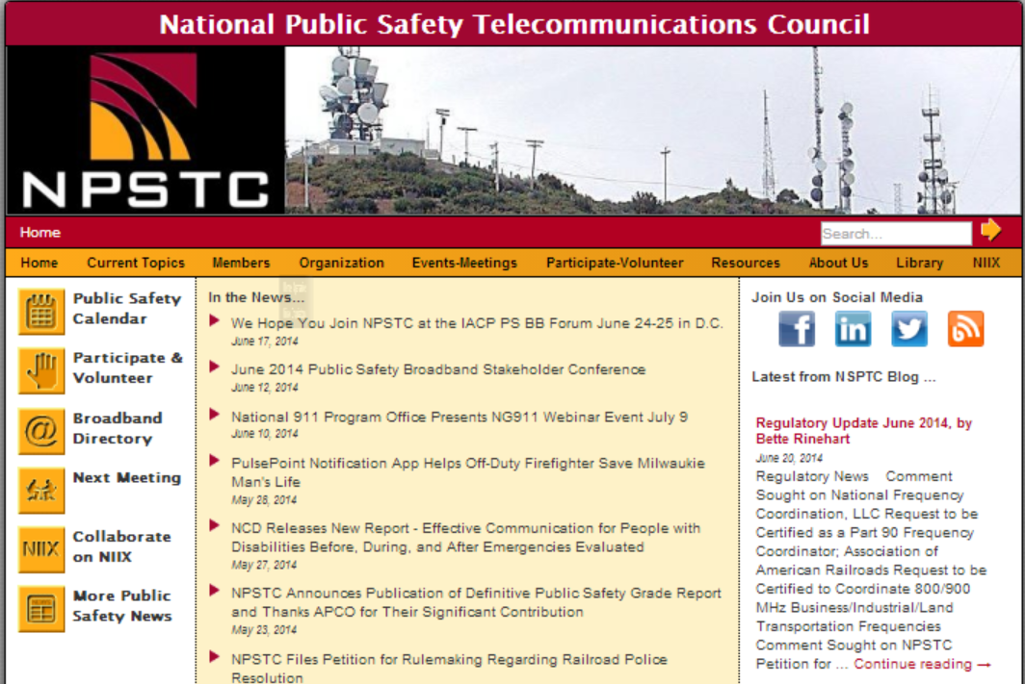
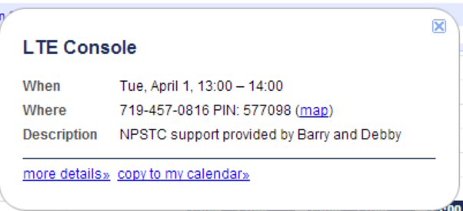
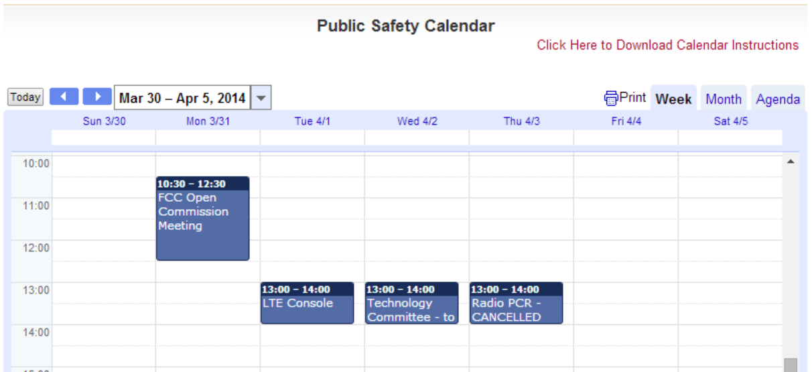
NPSTC Website and Calendar

Slide 34
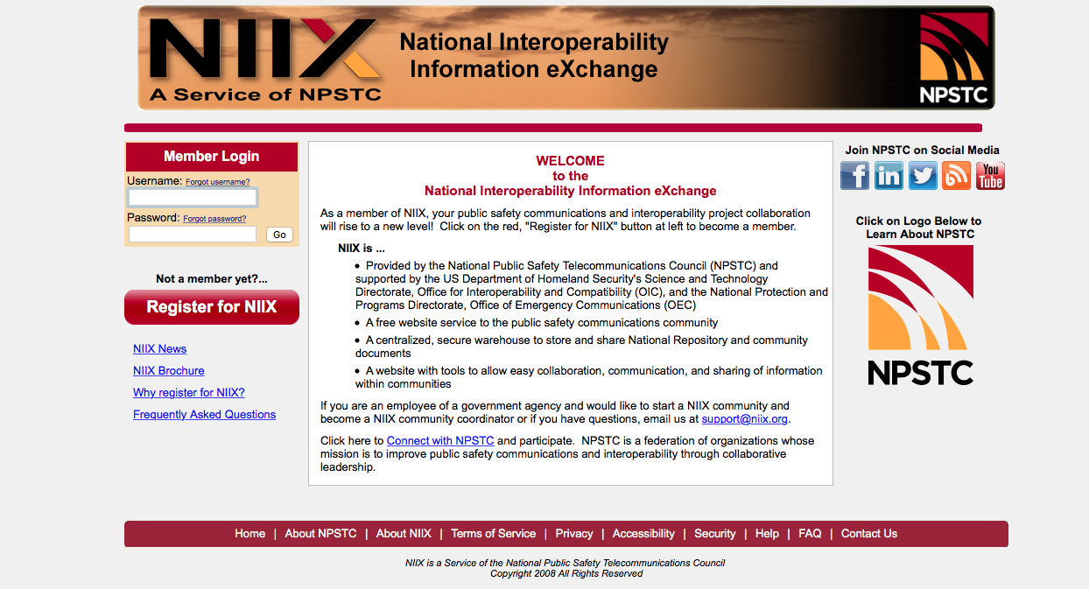
National Interoperability Exchange (NIIX)
NIIX
A free centralized, secure warehouse to store and share National Repository and community documents.
A website with tools to allow easy collaboration, communication, and sharing of information within communities

Slide 35
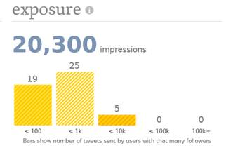
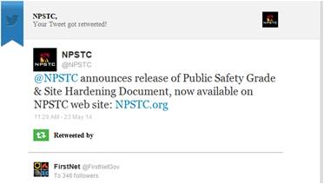
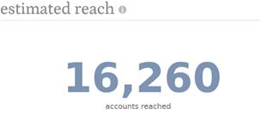
Social Media Outreach
Outreach and Distribution
Constant Contact
NPSTC Web Site
NPSTC Blog
Linked-In
Facebook
Twitter
Coordinate with industry publications
Broadband Directory

Slide 36
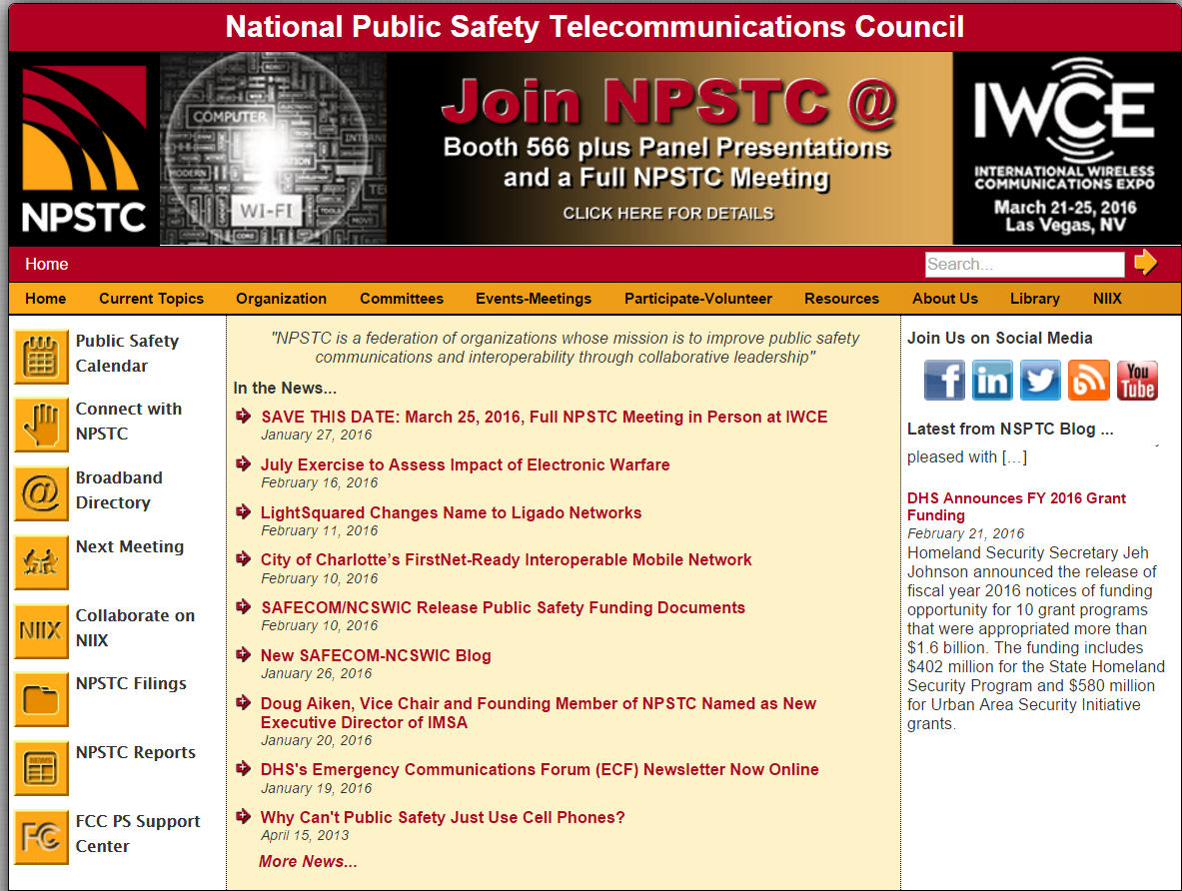
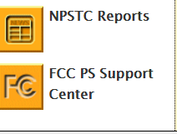
Reports Available for Review
Reports located on NPSTC website, www.npstc.org
Master 700 MHz Broadband SOR
Launch SOR Qualitative
Mission Critical Voice Over LTE
Public Safety Grade and Site Hardening Requirements
Local Control Definitions
Priority and Quality of Service
Push to Talk Requirements for Public Safety

Slide 37
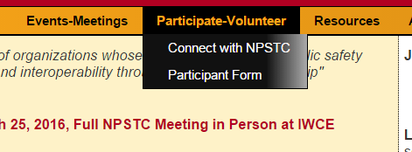
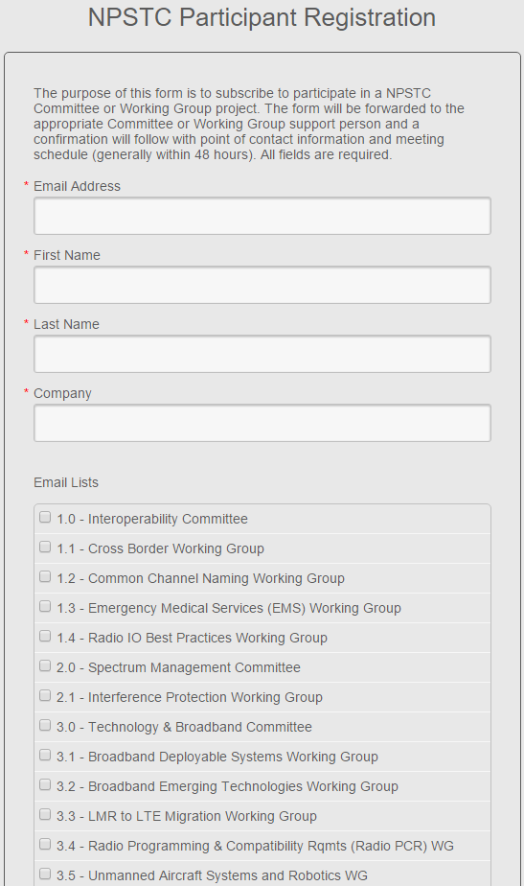
NPSTC Participation Sign Up

Slide 38
Thank you!
Questions?
support@npstc.org | 1.800.807.4755

