Slide 1
IACP Public Safety Broadband Forum
Washington, DC
Tuesday, June 24, 2014
Call In: (510) 227-1018 | Conference ID: 1927086
Webinar Access Information: https://join.me/npstcsupport1
Submit Questions Online Send email to “attend@npstc.org”
Notes:
1

Slide 2
IACP Public Safety Broadband Forum
Welcome
Vincent Talucci, IACP Executive Director
Opening
Ralph Haller, NPSTC Chair
Call to order
Roll Call
Interoperability Chair Retirement – John Powell
Interoperability Chair Appointment – John Lenihan

Slide 3
Federal Partners Update (1 of 3)
Department of Homeland Security (DHS)
John Merrill, Deputy Director, Office for Interoperability and Compatibility (OIC)
Ron Hewitt, Director, Office of Emergency Communications (OEC)

Slide 4
Federal Partners Update (2 of 3)
Federal Communications Commission (FCC)
Rear Admiral (ret.) David Simpson, Chief, Public Safety Homeland Security Bureau (PSHSB)
Roberto Mussenden, Attorney – Advisor, Policy and Licensing Division, Public Safety Homeland Security Bureau (PSHSB)

Slide 5
Federal Partners Update (3 of 3)
National Telecommunications & Information Administration (NTIA)
Mike Dame, Director, State and Local Implementation Grant Program (SLIGP)

Slide 6
Break

Slide 7
Federal Program Update
FirstNet
Kevin McGinnis, FirstNet Public Safety Board Member
Public Safety Advisory Committee
Harlin McEwen, Chairman

Slide 8
Topical Presentation
Integrated Justice Information Systems (IJIS) Institute
Ashwini Jarral, Director of Operations

Slide 9
NPSTC Six-Month Review
Barry Luke, Support Office
Notes:
9

Slide 10
NPSTC Six-Month Review
NPSTC Review
Presentation of NPSTC process and public safety initiatives
Many who join our meetings and working groups do not have a good understanding of what NPSTC is or what it does.
There is also a need to provide a high level overview to the NPSTC Governing Board on the “big picture” and emerging issues.
Notes:
This is the explanation on why we are doing this……

Slide 11
NPSTC Member Organizations
Member Organizations
American Association of State Highway Transportation Officials
American Radio Relay League
Association of Fish and Wildlife Agencies
Association of Public-Safety Communications Officials – International
Forestry Conservation Communications Association
International Association of Chiefs of Police
International Association of Emergency Managers
International Association of Fire Chiefs
International Municipal Signal Association
National Association of State Chief Information Officers
National Association of State Emergency Medical Services Officials
National Association of State Foresters
National Association of State Telecommunications Directors
National Emergency Number Association
National Sheriffs’ Association
Associate Member Organizations
Alliance for Telecommunications Industry Solutions
Canadian Interoperability Technology Interest Group
National Council of Statewide Interoperability Coordinators
Telecommunications Industry Association
Utilities Telecom Council
Liaison Organizations
Federal Communications Commission
Federal Emergency Management Agency
Federal Partnership for Interoperable Communications
National Telecommunications and Information Administration
DHS Office for Interoperability & Compatibility
DHS Office of Emergency Communications
Public Safety Communication Europe
SAFECOM
U.S. Department of Justice
U.S. Department of the Interior
Notes:
11
11
Less than one minute on this slide,
Note the breadth of public safety representation by various organizations
Note that NPSTC does not have elected or appointed officials in our organization
We are a federation of existing public safety centric organizations

Slide 12
NPSTC Member Organizations
Member Organizations
AASHTO
ARRL
AFWA
APCO – International
FCCA
IACP
IAEM
IAFC
IMSA
NASCIO
NASEMSO
NASF
NASTD
NENA
NSA
Associate Member Organizations
ATIS
CITIG
NCSIC
TIA
UTC
Liaison Organizations
FCC
FEMA
FPIC
NTIA
DHS OEC
DHS OIC
PSCE
SAFECOM
DOJ
DOI
Notes:
12
12
Note that this is how everyone recognizes the NPSTC organizations

Slide 13
NPSTC Overview (1 of 6)
Volunteer Driven Organization
All are welcome to participate
Public Safety, Industry, Commercial and “interested parties”
There are more than 1,500 active volunteers who participate on NPSTC committees, working groups, and task groups
There are more than 3,000 individuals who directly receive NPSTC reports, notices and information briefs

Slide 14
NPSTC Overview (2 of 6)
Three Main Committees
Interoperability Committee (John Lenihan & Pam Montanari)
Spectrum Management (David Buchanan & Stu Overby)
Technology Committee (Tom Sorley & Andrew Thiessen)
Broadband Working Group

Slide 15
NPSTC Overview (3 of 6)
Spectrum Management Committee
4.9 GHz National Plan Task Group
700 MHz Narrowband Working Group
Narrowbanding below 512 MHz
Specialized Communications Applications

Slide 16
NPSTC Overview (4 of 6)
Technology Committee
Radio PCR Working Group
Video Technology Advisory Group (VTAG)

Slide 17
NPSTC Overview (5 of 6)
Technology Committee
Broadband Working Group
Launch SOR Quantitative Task Team
Console LTE Task Team
Voice Over LTE/Mission Critical Voice Task Team
Public Safety Messaging (pending)
Public Safety Telephony (pending)
Year 2-3 Quantitative SOR (pending)
Year 2-3 Quantitative SOR (pending)
Local Control (pending)
Priority & Quality of Service (pending)
LTE Deployable Assets (pending)

Slide 18
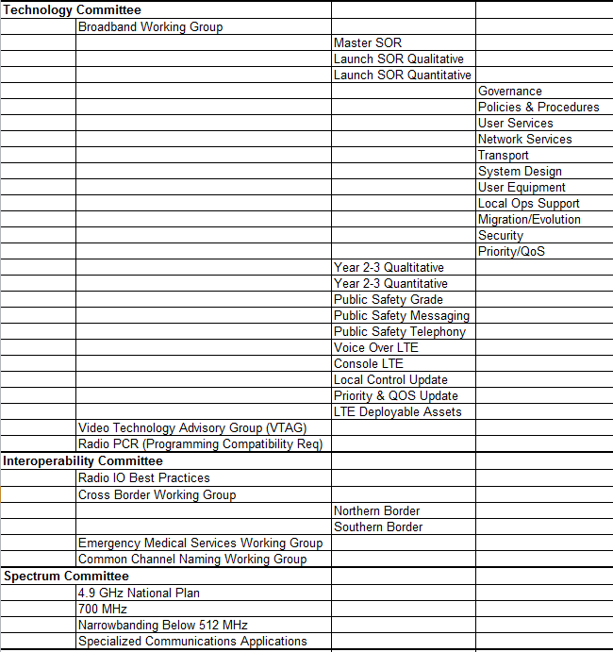
NPSTC Overview (6 of 6)
There have been more than 40 simultaneous groups active this year

Slide 19
Public Safety SOR Process
All Committee & Working Group activities are open to all interested parties.
Industry, commercial, and general government entities are welcome to join public safety representatives in all groups.
Participants can join a process at anytime, up through the final week of the project.

Slide 20
Public Safety SOR Process Steps
NPSTC task teams, including industry and public safety, develop requirements statements:
Qualitative
Quantitative
A Public Safety Review Team, including “new eyes”, conducts a final review of the document
Readability
Comprehension
Public Safety need articulated

Slide 21
Public Safety SOR Process Steps
Final draft document is sent back to the larger working group for comments, concerns and edits.
Document is concurrently sent to the Emergency Communications Preparedness Center (ECPC), for Federal review and input.
Final draft is sent to the NPSTC Governing Board for review, edit and approval.
Final document is posted on the NPSTC website and is sent to FirstNet Public Safety Advisory Committee (PSAC)

Slide 22
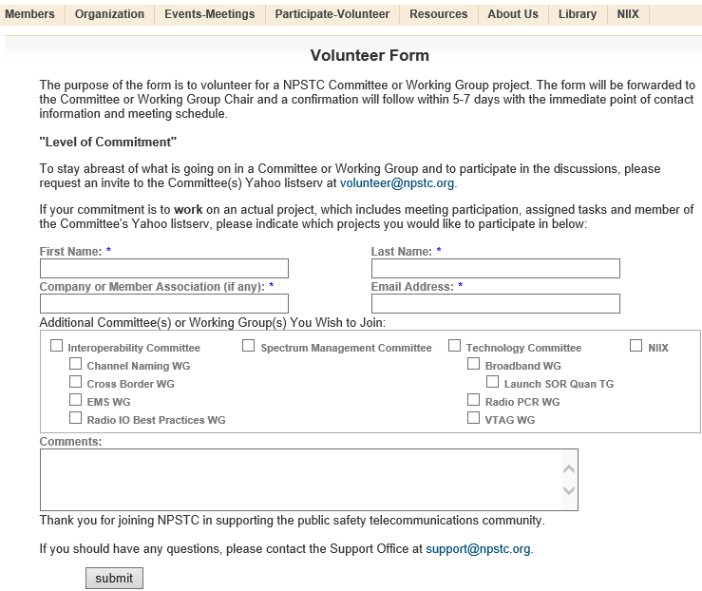
NPSTC Participation Sign Up

Slide 23
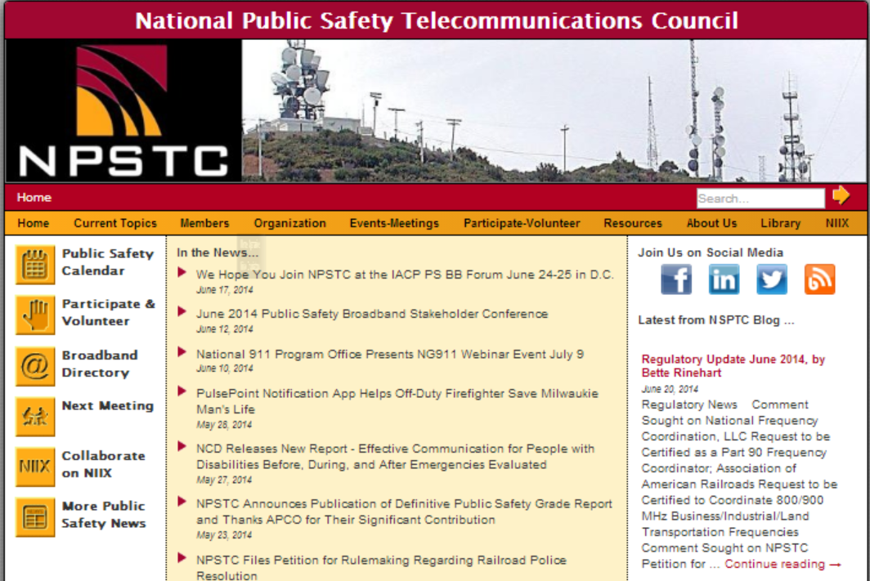
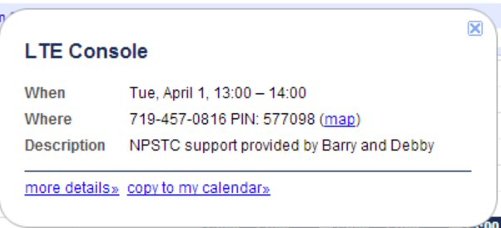
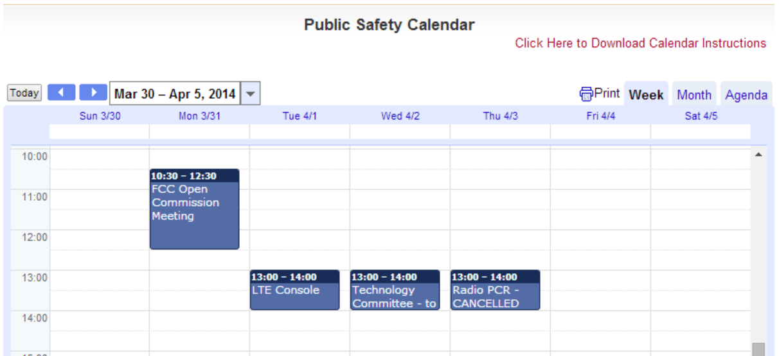
NPSTC Website and Calendar

Slide 24
NPSTC Overview
Group Coordination
Manage volunteer sign up and membership
Connect volunteer with their desired group
Manage all group communications
Email, Yahoo groups, SharePoint, conference lines, meeting reminders, calendar systems
Set group meeting agenda, record and distribute meeting minutes and documents.

Slide 25
NPSTC Overview
NPSTC also has interaction with Federal entities
Federal Communications Commission (FCC)
Emergency Communications Preparedness Center (ECPC)
Department of Commerce/Public Safety Communications Research (PSCR)
Canada/U.S. Cross Border Working Group (CANUS)
Federal agency personnel participate on NPSTC Committees, Working Groups and Task Teams
Approximately 70 federal employees are actively engaged
DHS-OEC, DHS-OIC, FBI, DOJ, CBP, PSCR, NTIA, NIST, NSA, FCC, Idaho National Laboratory, DOT, BLM, DOE, USPS, US Capitol Police, USDA.

Slide 26
NPSTC Overview
NPSTC participates in presentations and outreach efforts
GAO Inquiries (FirstNet, Receiver Performance, etc.)
FCC Workshops (IP Transition and GPS issues)
APCO International Conference, Broadband Summit and Emerging Technology Forum
IACP International Conference
IWCE Conference and Expo
CITIG Cross Border Workshops
ARRL Annual Conference
PSCR Annual Conference
DHS 100 second video on Public Safety Requirements

Slide 27
NPSTC Overview
Major Reports and Work Efforts
AFST Public Safety Communications Roadmap 2012-2022
T-Band Report, March 2013
4.9 National Plan, October 2013
Public Safety Grade Report, May 2014
Intrinsically Safe Radio Project (2010 – 2013)

Slide 28
NPSTC Overview
Major Reports and Work Efforts
2007 Broadband SOR
2009 Broadband Task Force Report
2011 Mission Critical Voice
2012 Priority and Quality of Service Report
2012 Local Control Report
2012 Multi-Media Emergency Services Report
2012 Launch SOR
2013 PTT over LTE
2014 Public Safety Grade Report
Notes:
Note that these were prior to PSST or First

Slide 29
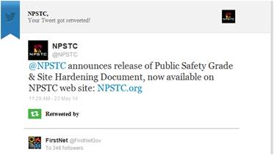
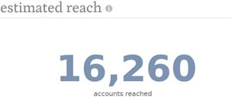
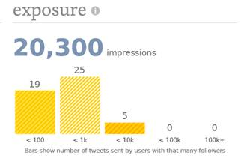
NPSTC Overview
Outreach and Distribution
Constant Contact
NPSTC Website
NPSTC Blog
Linked-In
Facebook
Twitter
Coordinate with industry publications
Resource CD
Produced biannually with reports and links to content

Slide 30
Emerging Issues
NG911 and FirstNet
NENA i3 standard for NG911 needs better exposure to public safety LMR and Broadband personnel.
There are many variations in how the NG911 ESInet and FirstNet may interconnect with the local Public Safety Enterprise Network (PSEN)
Public Safety agencies have expressed interest in not creating costly duplicate networks.

Slide 31
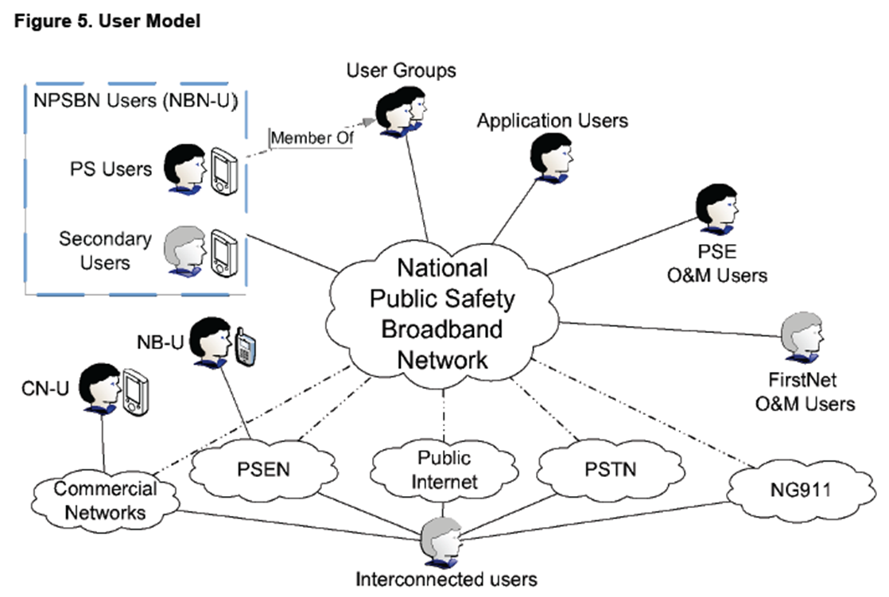
Emerging Issues
Intersection of NG911 and FirstNet

Slide 32
Emerging Issues
Video Technology
Video continues to generate significant interest in all public safety disciplines (Law Enforcement, Fire, EMS)
DHS S&T VQIPS Group has a core group of industry and public safety agency experts.
Video use on the Broadband Network requires coordination to ensure bandwidth efficiency.
Applications need to be tailored to manage video
Network priority schemes are needed to manage video
Agency policy on use of video is critical to support FirstNet’s mission

Slide 33
Emerging Issues
Requirements & Standards
NPSTC produces Public Safety Requirements; and is not a Standards Development Organization
There are multiple SDO’s in the public safety arena
There is contention regarding appropriate use of a North American standard vs. an international standard for certain broadband functionality.
There is contention on which public safety features and functions should be based on 3GPP LTE standards vs. managed as an over the top application.

Slide 34
Emerging Issues
Non P25 Solutions
Manufacturers of “non P25” products and solutions continue to court the public safety and critical infrastructure community.
They involve non P25 digital network solutions, like TETRA, MPT1327 and DMR.
They involve non P25 services like Motorola ADP encryption and OTAP
There is the potential to significantly undermine interoperability gains made over the last 10 years.

Slide 35
Emerging Issues
Broadband Issues
Updating NPSTC documents based on changing technology advances.
Local Control issues and options
Priority & Quality of Service
Monitoring new topics and issues
LTE Deployable assets
Credentialing and Identity Management

Slide 36
Emerging Issues
T-Band Crisis
Monitoring actions by the FCC and Congress regarding the legislatively mandated return of public safety T-Band Spectrum (470-512 MHz)
Heavily used in 11 metropolitan areas
Boston, Chicago, Dallas/Fort Worth, Washington DC, Houston, Los Angeles, Miami, New York City/New Jersey, Philadelphia, Pittsburgh and San Francisco/Oakland
NPSTC estimated it would cost 5.9 billion dollars to move public safety agencies off of the band (assuming spectrum could be located for their use)
Major impacts to interoperability will occur.

Slide 37
Emerging Issues
700 MHz narrowband issues
6.25 KHz Deadline still set for December 31, 2016
NPSTC is awaiting action by the FCC to delay or cancel this narrow banding requirement.
There are several other 700 MHz clean up actions that are pending with the FCC.

Slide 38
Lunch (on your own)

Slide 39
Technology Discussion
Tom Sorley, Chair &
Andrew Thiessen, Vice Chair

Slide 40
Public Safety Grade Report
Public Safety Grade Task Team – David Buchanan
Report approved and released on May 22nd
Transmitted to the FirstNet PSAC
Published to NPSTC website
Received significant media attention
APCO developing plan to convert Site Hardening section into an ANSI standard
APCO examining the Applications section for further standards development work.

Slide 41
Public Safety Grade Report
Public Safety Grade Report Chapters
Risk Factors
Environmental Events
Service Level Agreements
Reliability and Resiliency
Coverage
Push-to-Talk
Applications
Site Hardening (created by APCO)
Installation
Operations & Maintenance

Slide 42
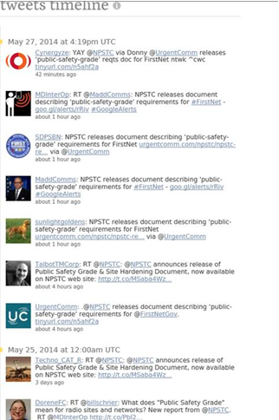
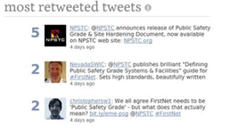
Public Safety Grade Report
Social Media Reaction
15,000 recipients in 48 hours

Slide 43
Technology Discussion
Public Safety Broadband Requirements Update – Andy Thiessen, Chair
PSCR Annual Meeting Review
June 3-5, Boulder
558 attendees split between public safety and industry
FirstNet Board of Directors “open meeting”
NPSTC presented on the Requirements & Standards development process and how NPSTC working groups operate.
Variety of technical presentations on PSCR work
All presentations are available on line www.PSCR.gov

Slide 44
Broadband Requirements Update
Historical Review and Timeline

Slide 45
Broadband Requirements Update
2004 SAFECOM Statement of Requirements (SoR)
2007
NPSTC BBWG SoR
2009
NPSTC BBWG Task Force Report
2011
NPSTC Mission Critical Voice Requirements
2011-2012 NPSTC BBWG SoR

Slide 46
Requirements: Where have we been?
2004 SAFECOM Statement of Requirements (SoR)
2007
NPSTC BBWG SoR
2009
NPSTC BBWG Task Force Report
2011
NPSTC Mission Critical Voice Requirements
2011-2012 NPSTC BBWG SoR

Slide 47
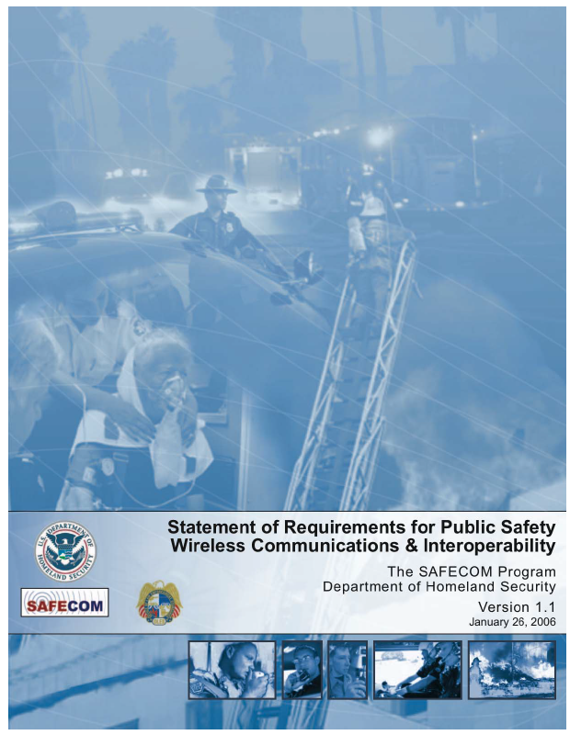
Requirements: Where have we been?
2004 SAFECOM Statement of Requirements
Who, what, why, when operational understanding
Readers digest of future public safety thinking

Slide 48
Requirements: Where have we been?
2004 SAFECOM Statement of Requirements (SoR)
2007
NPSTC BBWG SoR
2009
NPSTC BBWG Task Force Report
2011
NPSTC Mission Critical Voice Requirements
2011-2012 NPSTC BBWG SoR

Slide 49
Requirements: Where have we been?
2007 NPSTC Broadband Working Group (BBWG) Statement of Requirements
Based on public-private partnership

Slide 50
Requirements: Where have we been?
2004 SAFECOM Statement of Requirements (SoR)
2007
NPSTC BBWG SoR
2009
NPSTC BBWG Task Force Report
2011
NPSTC Mission Critical Voice Requirements
2011-2012 NPSTC BBWG SoR

Slide 51
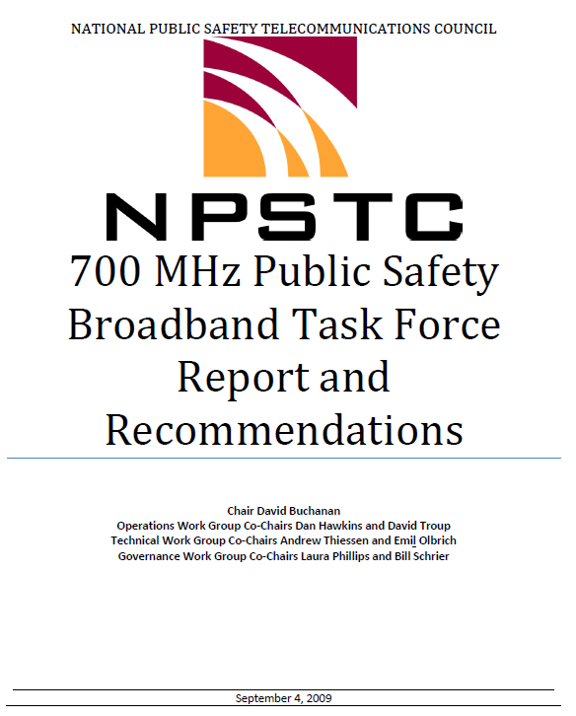
Requirements: Where have we been?
2009 NPSTC BBWG Task Force Report
Public safety selects LTE
LMR model for procurement and operation

Slide 52
Requirements: Where have we been?
2004 SAFECOM Statement of Requirements (SoR)
2007
NPSTC BBWG SoR
2009
NPSTC BBWG Task Force Report
2011
NPSTC Mission Critical Voice Requirements
2011-2012 NPSTC BBWG SoR

Slide 53
Requirements: Where have we been?
2011 Mission Critical Voice Requirements
BBWG seeks to define features/functions that make up mission critical voice
direct mode (standards work)
push to talk (standards work)
cellular telephony (TBD)
voice quality (audio quality testing)
emergency alerts (TBD)
group communications (standards work)

Slide 54
Requirements: Where have we been?
2004 SAFECOM Statement of Requirements (SoR)
2007
NPSTC BBWG SoR
2009
NPSTC BBWG Task Force Report
2011
NPSTC Mission Critical Voice Requirements
2011-2012 NPSTC BBWG SoR

Slide 55
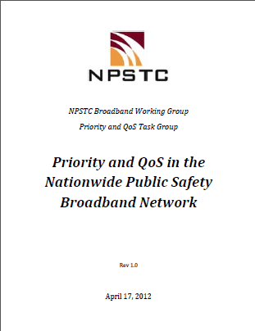
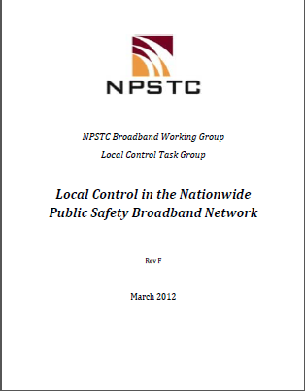
Requirements: Where have we been?
2011-2012 NPSTC BBWG Task Group Efforts
Priority/Quality of Service
Local Control

Slide 56
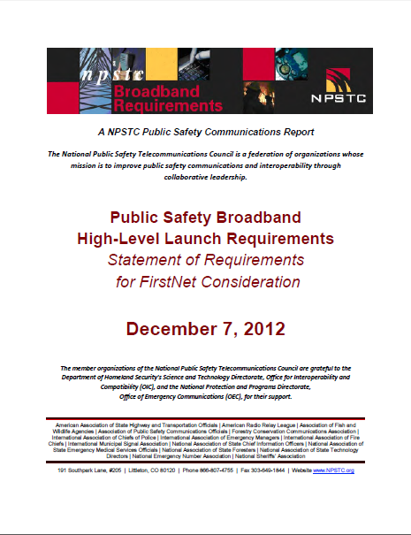
Requirements: Where have we been?
2012 NPSTC BBWG Launch SOR
Delivered a qualitative set of requirements to FirstNet BoD
Not a “how to” report
Answered the question of what would FirstNet need to do that public safety would feel compelled to take service

Slide 57
Broadband Requirements Update
Where are we today?

Slide 58
Broadband Requirements Update
Console LTE
Examining impact of FirstNet features and functionality on dispatch center workstations
Receipt, Sharing and Transmission of video
Processing sensor data from smart devices (M2M)
Adding authorized users to an incident for priority access
Use cases developed, action items reviewed, requirements developed
29 public safety requirements identified
Completion, July 2014

Slide 59
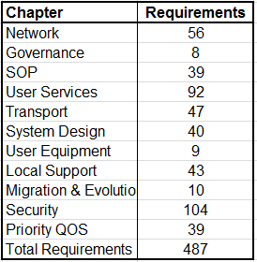
Broadband Requirements Update
Launch SOR Quantitative
Using Launch SOR Qualitative document as base
487 total requirements
108 were flagged for metrics
Working with FirstNet technical team to identify focused approach - working on individual topics
This will produce timely individual results vs. the “heavy lift” to revise the entire SOR.

Slide 60
Broadband Requirements Update
Local Control document refresh
NPSTC published original Local Control report in March of 2012
There is now a better understanding of public safety operational needs and LTE system capabilities.
Need to examine technical and operational issues

Slide 61
Broadband Requirements Update
Refresh on Priority & Quality of Service document
NPSTC published original Priority & QoS document in April of 2012.
Need to examine original report against new technology capabilities and options
Need to examine how technical options best fit public safety operational needs

Slide 62
Broadband Requirements Update
Deployable LTE Systems, joint project with Canada
Canada’s Centre for Security Science has requested U.S. DHS participation with their proposed working group to examine LTE deployables
Canada is very interested in studying impacts of deployable technologies along the border.
FirstNet is very interested in the use of deployables for coverage in rural areas.
Deployable assets include vehicle mounted, UAV, balloon and other aerial systems.

Slide 63
Broadband Requirements Update
Longer Term Public Safety Broadband Projects
SOR, Year 2-3 Qualitative Assessment
Public Safety Telephony requirements review
Public Safety Messaging requirements review
SOR, Year 2-3 Quantitative Assessment

Slide 64
Broadband Requirements Update
Globalization of LTE Standards
3GPP meeting held in France in June
Mission Critical Voice standards development
Desire to keep this in 3GPP process
Others are advocating for other SDO routes
Next slides show broadband requirements and standards development organizational relationships

Slide 65
Pre-FirstNet Broadband Efforts

Slide 66
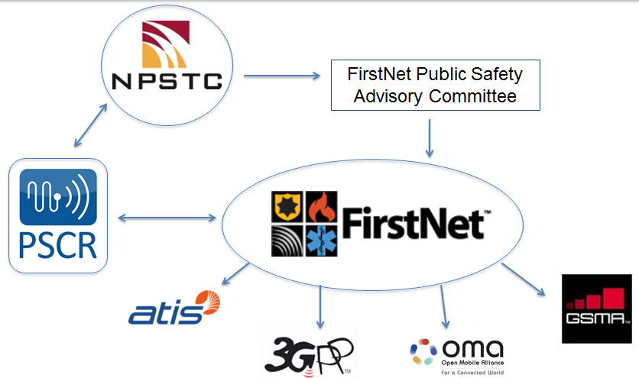
FirstNet Standards Process

Slide 67
FirstNet Standards Strategy
Mission Critical Voice
Use MC PTT as the goal for what needs to be standardized in LTE barring errors found
Global Reach
Ensure global public safety market
Widen Manufacturer Base
More diverse vendor set given the move to a globally accepted commercial technology

Slide 68
Mission Critical Voice
Two modes of operation acceptable
Push To Talk
Traditional Cellular Telephony
Direct Mode
Group Communications
Audio Quality
Speaker Identification
Emergency Alerting

Slide 69
Global Public Safety Market
United States estimated at 3 to 5 million public safety users
60,000+ agencies, 8000+ land mobile radio networks
United Kingdom estimated at 300,000 public safety users
Canada, France, Australia, Germany, South Korea, etc.
Global estimate of 45 Million public safety users

Slide 70
3GPP Release Process
3GPP uses a system of parallel “releases” to provide developers with a stable platform for implementation and to allow for the addition of new features required by the market
Each release has three phases of a “freeze” which means that no additional features can be added after each successive freeze

Slide 71
3GPP Release Process
Release 12
Stage 1 Freeze is March 2013
slipped to June 2013
Stage 2 Freeze is December 2013
slipped to March 2014
Stage 3 Freeze is June 2014
slipped to December 2014
Protocols stable 3 months later

Slide 72
3GPP Release Process
Release 13
Stage 1 Freeze is September 2014
expected to slip three months
Stage 2 Freeze is June 2015
Stage 3 Freeze is March 2016
Typically a desired feature will appear two years after a Stage 1 Freeze or one year after a Stage 3 Freeze

Slide 73
3GPP Structure
Technical Specifications Group (TSG) Structure
TSG GERAN
GSM EDGE Radio
Access Network
TSG RAN
Radio Access
Network
TSG SA
Service &
Systems Aspects
TSG CT
Core Network &
Terminals
GERAN WG1
Radio Aspects
RAN WG1
RL 1 Spec
SA WG1
Services
CT WG1
MM/CC/SM (lu)
GERAN WG2
Protocol Aspects
RAN WG2
RL 2 Spec
RL 3 RR Spec
SA WG2
Architecture
CT WG3
Interworking w/ Ext networks
GERAN WG3
Terminal Testing
SA WG3
Security
CT WG4
MAP/GTP/BCH/SS
RAN WG3
Lub, lur, lu specs
UTRAN O&M Reqs
SA WG4
Codec
CT WG6
Smart Card App Aspects
RAN WG4
Radio Perf
Protocol Aspects
SA WG5
Telecom Mgt
RAN WG5
Mobile Terminal
Conformance Testing

Slide 74
Direct Mode
3GPP: Proximity Services (Direct Mode) – REL 12/13
Current progress to date for REL 12
Communications
In and out of network included
Discovery
In network only included
Relaying
Ue-to-Ue and Ue-to-Network not included
Next steps
REL 13 work to include REL 12 unaddressed work
Looking at adding priority to LTE direct mode

Slide 75
Group Efficiency
3GPP: Group Efficiency (Group communications) – REL 12/13
Current progress to date
Normative, standards track
Next steps
Group Management back for REL 13
Determine potential to test eMBMS in laboratory

Slide 76
PTT
3GPP: MC PTT – REL 13
Current progress to date
Normative, standards track
Stage 1
In progress at 60 percent completion
Note that there was objection to rapporteur estimation of 60 percent
Large unknown with OMA and TCCE requirements
Stage 2
Began two weeks ago, largely informative discussion
No formal approval of WID (June SA Plenary)
Potential contention regarding where to standardize PTT

Slide 77
Standards Summary
What we have learned
Public safety LTE is a global market
We have worked closely with:
TETRA CCA
APCO Global Alliance
In particular USA, Australia, Canada, and Britain
Canadian Government and Canadian Interoperability Technology Interest Group (CITIG)
We have been successful because of the global partnerships
Each effort requires different partners depending on varied business interests

Slide 78
Standards Event Calendar 2014
Events:
[3GPP] SA1 Working Group – May 2014 – Sapporo
MC PTT week of May 12, critical meeting for progress, REL 13 starts for PRoSe and GCSE_LTE
[3GPP] SA3 Working Group – May 2014 – Sapporo
Security aspects for PRoSe and GCSE_LTE
[3GPP] SA2 Working Group – May 2014 – Phoenix
Working begins on MC PTT, along with continued discussions for REL 13 PRoSe and GSCE_LTE
[3GPP] RAN1 & RAN2 Working Groups – May 2014 – Seoul
Continued standardization of ProSe
[3GPP] RAN & SA Plenary – June 2014 – Sophia Antipolis
Discussion about changes, if any, to the standardization of MC PTT across 3GPP, OMA, and ETSI

Slide 79
Broadband Requirements Update
Question and Answer

Slide 80
Radio Programming Compatibility Requirements Working Group Update
Co-Chairs Tom Sorley & Pam Montanari

Slide 81
PAM Tool
Current State
BETA release A1 available, www.npstc.org/radioPCR.org
Version A2 will be released after this week’s meeting
Raw Data Set, defined and locked to allow vendors to start development and implementation of export/import capabilities in vendor programming software
Manual data entry
Support for Conventional Analog, Conventional P25 and P25 Trunking (Phase 1 and 2)
Multi-vendor cross reference of terms for programming fields
Updated Manufacturers conversion information and added Midland to manufacturers
Scheduled to provide an overview and Demo at APCO

Slide 82
PAM Tool
Next Steps
Incorporation of NIFOG (As a whole and by frequency band Low, VHF, UHF Lo/Mid/Hi, 700, 800)
Finish User Interface Tab to allow easy viewing of single channel/system/talk group
Integration of IC205 and IC217 into tool
Integration into NWCG and All Hazards COML/COMT curriculum and training
Integration into CASM
Identify a Single Point of Contact for each Manufacturer
Long Term Goal
Integration into OEC programs and offerings where it can be maintained and updated

Slide 83
PAM Tool
User Participation
Download the Tool and start to use it.
Pre-populate the Tool for local and regional area similar to IC217
Regularly use tool in response and with programming software
User Goal
Pam Tool to become an integrated part of user’s day-to-day interoperability toolbox like the NIFOG, TICP and CASM

Slide 84
PAM Tool
Manufacturer Participation and Goals
Tool designed to allow user interface to change and grow without raw data set changing.
Public safety needs vendors to move forward with development and implementation of export/import to the Tool from vendor software.
No proprietary vendor information needs to be released
As new features (DMR/NXDN/IDAS/future P25) are included the current raw data set will not be affected

Slide 85
PAM Tool
Development Assistance
Automation of single channel/system/talk group tab
Automation of NIFOG integration
Automation of IC205/IC217 integration
Integration into All Hazards COML/COMT curriculum and training
Integration in to CASM
Event / Response Demos
Conference Demos
User Training
Distribution – Responder Toolkit
Tool for download on Public Safety Tools website

Slide 86
Interoperability Discussion
John Lenihan, Chair &
Pam Montanari, Vice Chair

Slide 87
Interoperability Discussion
Common Channel Naming – Don Root, Chair
Initiatives
700 MHz nationwide interoperability channels
32 I/O frequency pairs with 8 Air to Ground pairs
Analog Itinerant Channel Naming
Awaiting FCC action on additional 700 MHz clean up and channel identification
Statewide Channel Naming Best Practices
Recommended naming convention for use with statewide interoperability frequencies.

Slide 88
Interoperability Discussions
Emergency Medical Services Working Group– Barry Luke, Support Office
EMS Broadband Applications List was approved by NPSTC in November 2013 and transmitted to the FirstNet PSAC.
EMS WG also reviewed the law enforcement and fire/rescue applications list and assisted in combining the PSAC and NPSTC lists. That review was completed in May.

Slide 89
EMS WG Update
Currently using the working group for feedback on Local Control issues.
Local Control tutorial was provided on June 9th covering basic Priority QoS issues and introducing several scenarios
July meeting will be a discussion about which Local Control technical solutions have the best operational fit.
A survey will be conducted during July
Results will be presented at the August EMS WG meeting.

Slide 90
Interoperability Discussion
Border Issues Working Group – Barry Luke, Support Office
APCO Emerging Technology Forum in Toronto, May 20th
US/Canada Working Group, CANUS, June 17

Slide 91
Border Issues Update
Regulatory Updates
Industry Canada has posted information on their licensing and interference analysis process
Industry Canada now provides the Call Sign of the entity which triggered the denial of the U.S. license request.
FCC granted the State of Montana a waiver to expand use of VLAW 31 (Blue Channel) to include fire/rescue and EMS
FCC granted the State of Washington a waiver to use a U.S. designated paging frequency to interconnect with a Canadian cross border system.

Slide 92
Border Issues Update
Regulatory Updates
FCC and Industry Canada have harmonized the 700 MHz narrow band frequencies
FCC and Industry Canada have harmonized the 800 MHz band
The FCC and Industry Canada are actively working on harmonization of the 700 MHz broadband spectrum.

Slide 93
Border Issues Update
Regulatory Updates - PENDING
The FCC and Industry Canada have agreed on terms to extend use of hand held radios across the border, based on the original terms of the 1952 Treaty
This is Scenario #1 identified in the NPSTC/CITIG report.
Law Enforcement, Fire, and EMS organizations would be permitted to roam across the border
The update has been agreed to at the staff level and is currently in final review by both countries legal teams.

Slide 94
Border Issues Update
Regulatory Updates - PENDING
The FCC and Industry Canada have identified a “manual coordination” path for special condition licensing:
Placement of a base station in Country “B” to support cross border interoperability between Country “A” and “B”
Placement of a base station in Country “B” to support local operations in Country “A”.
This addresses Scenario #2 and #3 in the NPSTC/CITIG report.
The FCC and Industry Canada are working to document the report that will provide guidance to licensees on how to file.

Slide 95
Border Issues Update
Bi-National Working Group
NPSTC’s Border Issues WG will join the CITIG Border Group to formally work with DHS-OEC and Public Safety Canada on cross border interoperability issues
Provides assistance for the CANUS Working Group, Goal 8, Activity 8.1:
“Identify and confirm mechanism to maintain cross border communications interoperability coordination outside the confines of the Beyond The Border (BTB) 32b.

Slide 96
Border Issues Update
Bi-National Working Group
Establish monthly conference calls
Identify and invite local and state public safety personnel who are involved in border issues
CITIG will invite local and Provincial public safety personnel.
Goal is to have a geographically diverse, discipline diverse group that includes technical and operational personnel
DHS OEC Regional Coordinators who work with border states will also contribute to the project.

Slide 97
Border Issues Update
White Paper Border Issues Report
Report Outline
Executive Summary
Introduction
Statement of Problem
Current Regulatory Environment
Cross Border Work Efforts
Barriers and Opportunities
Initial Recommendations
Best Practices Model
Resource Links

Slide 98
Border Issues Update
Project Timeline
Start in July
Finalize draft report in September
Present draft report at CITIG Bi-National Cross Border Conference, October 20-22, in Windsor
Have Town Hall presentation and feedback session
Finalize report recommendations in November
Submit to NPSTC and CITIG Boards for approval

Slide 99
NPSTC Thanks the Award Sponsors

Slide 100
Participants Award
Created to recognize individuals who have supported NPSTC and the public safety community on critical objectives.
2014 Recipient: Jason Matthews

Slide 101
Leadership Award
Created to recognize individuals and and/or organizations for their exceptional work in advancing the causes of public safety communications
2014 Recipient: Terry Hall

Slide 102
Hertz Award
Named for Heinrich Hertz who names denotes the scientific unit of frequencies, cycles per second.
Awarded for extraordinary leadership in public safety communications.
2014 Recipient: David Buchanan

Slide 103
Atkinson Technical Award
Created as a memorial award in 2012 to honor PSCR employee, D.J. Atkinson, who was instrumental in improving public safety communications.
Awarded for exceptional technical vision and support
2014 Recipients:
Tom Sorley
Pam Montanari
Scott Glazer
Ken Link
Paul Roberts
Dan Robinson

Slide 104
Chairman’s Award
Awarded by the NPSTC Chair to recognize exceptional leadership in advancing public safety communications objectives.
2014 Recipient: Steve Devine

Slide 105
DeMello Award
Named for Richard DeMello who served as a founding member of NPSTC and who was instrumental in forming relationships with public safety organizations and frequency coordination groups.
Awarded to a single individual who has demonstrated the highest levels of personal and professional conduct with public safety communications.
2014 Recipient – Dr. David Boyd

Slide 106
Recess reconvene at 8:30 a.m.

