Slide 1
NPSTC General Meeting at IWCE March 25, 2016
Project 25 Technology Interest Group (PTIG)
Update for 2016
Presented by:
Stephen Nichols, Director PTIG
www.project25.org

Slide 2
Project 25 Standards Update: January 2016
Completed in 2016:
General
A revision of TSB-102 (TIA-102 Documentation Suite Revision C) was approved for publication. The Telecommunications Systems Bulletin RevC reflects TR8 progress since the last publication (2012), including new TIA publications, improved graphics, and addresses miscellaneous errata identified.
Air Interfaces
A revision to the FDMA, TDMA and Analog Air Interface Performance Measurement Method Standards were approved for publication. These revisions will ensure that harmonics present in Class D amplifiers do not interfere with various audio measurements.
Broadband
A revision of TSB-88.2-E (Wireless Communications Systems – Performance in Noise and Interference Limited Situations – Part 2: Propagation and Noise) was approved for publication. The revisions add information associated with Broadband Air Interface Propagation and Noise modeling.
Notes:
2
2

Slide 3
Project 25 Standards Update: January 2016
Work in Progress:
Air Interfaces
A revision to the FDMA Common Air Interface Standard is in progress. This revision addresses errata that have been collected since the last publication.
A revision to the Trunking Interoperability Test Standard is in progress. This revision merges the FDMA and TDMA material and address an error in a call pre-emption test procedure.
A new standard for a TDMA Control Channel is in progress. This standard provides the messages and procedures for operating a 12.5 kHz channel with 2 TDMA slots where either or both may service Control Channel traffic.
Notes:
3
3

Slide 4
Project 25 Standards Update: January 2016
Work in Progress:
Security
Link Layer Encryption is in progress. This is the first big new technology upgrade for improved Security for all air interfaces of P25. It protects control channel control messages, and hides group and individual IDs.
An addendum to the Key Fill Interface standard is in progress. This will enable Key Fill Device (KVL) interface to a KMF, an Authentication Facility and another Key Fill Device
Wireline Interfaces
An addendum to the ISSI Messages and Procedures Standard is in progress. The revision corrects several errata that have been noted since the last publication.
A revision to the Fixed Station Interface Standard is in progress. This revision adds additional capabilities the most significant of which is Packet Data.
Additions to the Trunking ISSI Messages and Procedures Standard are in progress. The additions will add Individual and Group Regrouping capability associated with Console “Patch” type operations.
Notes:
4
4

Slide 5
Project 25 Standards Update: January 2016
Work in Progress:
Broadband
Public Safety requirements for Broad Band Data/LMR Interoperability is in progress in a joint ATIS/TR8.8 effort. This is the beginning of work to create the requirements for interworking of Broadband and Existing P25 LMR systems. This effort is currently on hold pending advancement of the 3GPP Mission Critical services architecture. A new ATIS ad hoc group has begun an effort to gather interworking requirements and scenarios for Broadband Mission Critical services and Land Mobile Radio Technologies such as Analog FM, P25 and Tetra.
Additions to TSB-88 are in progress. These additions will create recommendations for Broadband Data System coverage modeling and verification.
Notes:
5
5

Slide 6
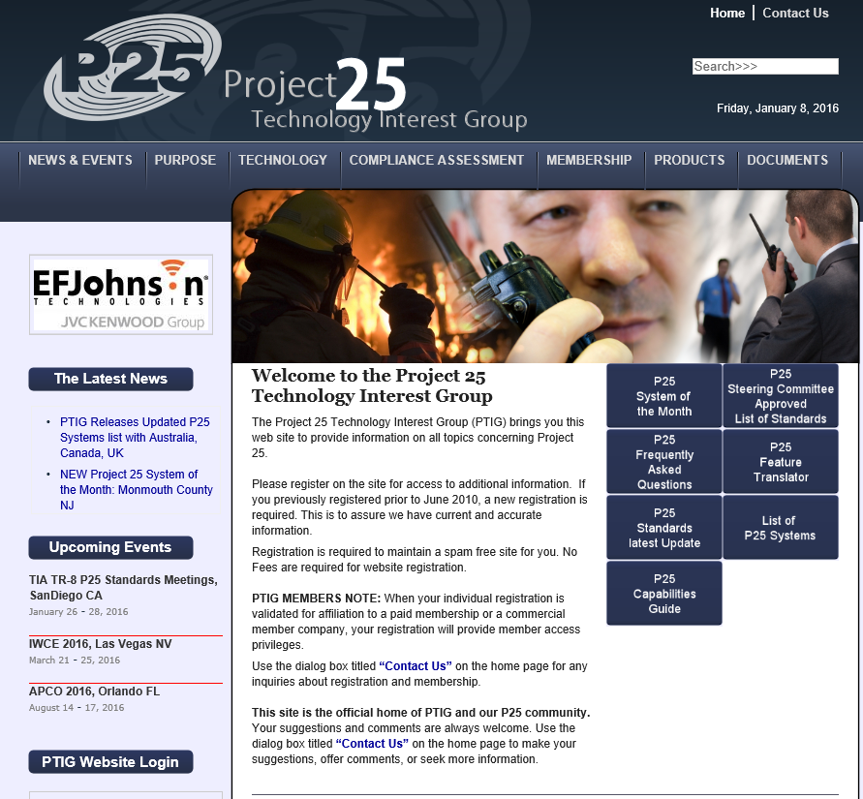
WWW.Project25.org

Slide 7
Project 25 Technology Interest Group (PTIG)
Documents available at www.Project25.org
P25 Frequently Asked Questions (FAQ)
Written to officer, firefighter (non technologist) level
P25 Capability Guide
Added Infrastructure interfaces and links to Statement of Requirements. Remains the best tool for managing P25 features and capabilities for system planning and RFP development
P25 Standards Update Summary
Summary of the latest TIA TR-8 P25 Standards Meetings with user benefits defined
P25 Steering Committee Approved List of Standards
Updated from the most recent P25 Standards meeting
P25 Feature Translator
link to NPSTC PAM tool
Notes:
7
7

Slide 8
Project 25 Technology Interest Group (PTIG)
New Documents available at www.Project25.org
New White paper: P25 Automatic Roaming
A detailed description of Automatic and Manual Roaming capability for Project 25 systems.
P25 System of the Month
Each month a new Project 25 system is featured describing the system, coverage, agencies served, interoperability achieved and other unique details of this application of Project 25 technology. Current Month Queensland Australia
New White Paper: Is Project 25 Public Safety Grade?
Project 25 has been defined since it’s inception by requirements from the Public Safety User Community. The result is a Suite of Standards with well defined features, capabilities, and interoperable interfaces applied in over 700 Public Safety Systems across the US today.
Notes:
8
8

Slide 9
Project 25 Technology Interest Group (PTIG)
Projects Underway 2016:
Expanded List of P25 Systems: New entries for International P25 systems and USA P25 Conventional systems will be added.
This resource will be expanded to include P25 systems beyond the systems currently listed for the USA, Australia, Canada, New Zealand, and the UK.
FAQ Guide will be updated with latest Questions
CAP testing, CAP Certification, Automatic Roaming, Unit ID Duplication Questions.
P25 Steering Committee By-Laws to be added as a resource
Benefits of P25 Whitepaper
The Benefits of P25 Whitepaper is the most clicked on document on the PTIG WEB site. It was last updated in 2013. The new update includes additional Standards for ISSI, CSSI, and FSI and the benefits that they offer to users.
Notes:
9
9

Slide 10
Project 25 Systems List
 | UNITED STATES | P25 SYSTEMS
STATE | SYSTEM NAME | P25 | P25 | Comments | System User | Freq. Band
Alabama | Center for Domestic Preparedness | Phase 1 |  |  | 1st Responders | UHF Lo
 | Dothan Public Safety | Phase 1 |  |  | Public Safety | 800
 | Fort Benning Military | Phase 1 |  |  | DOD | UHF Lo
 | Fort Rucker | Phase 1 |  |  | DOD | VHF
 | Gadsden & Etowah County | Phase 1 |  |  | Public Safety | 700
 | Jefferson County | Phase 1 |  |  | Public Safety | 800
 | Marshall Space Flight Center | Phase 1 |  |  | Fed Agency | UHF Lo
8 | Maxwell Air Force Base | Phase 1 |  |  | DOD | UHF Lo
 | Alabama First Responder Network |  | Phase 2 |  | Public Safety | 700/800
 | Anniston Army Depot ANAD |  | Phase 2 |  | Public Safety | UHF Lo
3 | Shelby County First Responders |  | Phase 2 | New | Public Safety

Slide 11
Project 25 Technology Interest Group (PTIG)
Other News at www.Project25.org
P25 CSSI logs over 5 Million Hours Zetron’s Acom integrated dispatch system products utilizing the TIA Project 25 (P25) CSSI have logged more than 5 million hours of successful operation at customer sites throughout North and South America and Australia.
New P25 Paging Solution to Improve Communications for First Responders in Michigan
Currently, MPSCS subscribers may need two separate systems to dispatch emergency crews, one for the radios they use at the scene of an incident and another for the pagers that summon emergency responders. This new capability using Unications’ P25 pagers will provide both functions in one single P25 system. Additionally, the new solution will notify first responders if they are out of communication range, a confirmation the current method does not
8 Suppliers Participate in P25 Trunked Interoperability Event
Past P25 Systems of the Month:
Miami/Dade County FL, Lexington KY, Monmouth County NJ
.
Notes:
11
11

Slide 12
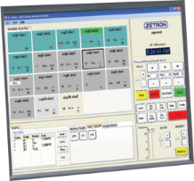
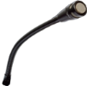
35 Vendors for Project 25 Equipment and Services
New P25 Pager and P25 Vehicle Repeater categories
15 fixed station/repeater suppliers
13 Subscriber suppliers
12 console suppliers
15 network providers
4 test equipment suppliers
7 consultant services
Console
power
audio
Channel A
Channel B
Available in VHF, UHF, 700, 800, and 900 MHz

Slide 13
Project 25 Products and Services Available
PTIG Member Organizations www.Project25.org | Fixed Stations & Repeaters | Mobile & Portable Radios | Pagers | Vehicle Repeaters | Consoles | Networks | Software | Test Equipment | Systems Integration | Consultant Services
AECOM
AIRBUS DS COMMS
AVTEC
BAI (FORMERLY AIRWAVE)
CATALYST
CISCO
COBHAM
CODAN RADIO (FORMERLY DANIELS)
DVA CONSULTING
DVSI
EF JOHNSON
ETHERSTACK
FEDERAL ENGINEERING, INC
5 x 9 COMMUNICATIONS
FUTURECOM SYSTEMS
GENESIS GROUP
HARRIS CORPORATION
ICOM AMERICA
IDA CORPORATION
JVC KENWOOD
MIDLAND RADIO
MOTOROLA SOLUTIONS
PANTEL INTERNATIONAL
POWERTRUNK (TELTRONIC)
RELM WIRELESS
SIMOCO
SPECTRA ENGINEERING
STANDARD COMM PTY LTD - GME
TAIT COMMUNICATIONS
TECHNISONICS
TELEX RADIO DISPATCH (BOSCH)
TIMCO ENGINEERING
UNICATIONS USA
VERTEX STANDARD
ZETRON
35 | 15 | 13 | 1 | 4 | 12 | 15 | 6 | 4 | 17 | 7

Slide 14
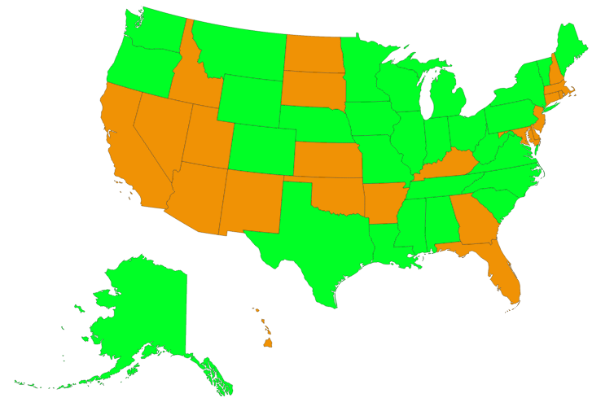
Current Systems
700+ P25 trunking systems in all 50 states and US Territories
26+ Statewide P25 systems
P25 Conventional Systems count TBD
State contains city, county, or multiple county P25 system
State contains statewide P25 system + other P25 systems

Slide 15
Steve Nichols, Director
Project 25 Technology Interest Group
director@project25.org

