Slide 1
Office for Interoperability & Compatibility (OIC) Update
National Public Safety Telecommunications Council Meeting – May 6, 2015
John Merrill
OIC Director First Responders Group (FRG) Science and Technology Directorate

Slide 2
OIC Mission
To provide the science and technology that enables emergency communications and facilitates the seamless exchange of information to save lives and protect property.

Slide 3
Organization Updates
John Merrill
OIC Director / NGFR Apex Program Manager
Jeff Booth
Information Applications & Standards (IAS) Director
NGFR Apex Program
Voice & Data Communications
Alerts, Warnings & Notifications (AWN)
Information Sharing
Apex Communications & Networking Engine (CNET)
Responder Technology Alliance
Apex Situational Awareness & Decision Support Engine (SANDS)
SLTT Information Sharing Governance
Prize Competition
Social Media

Slide 4
Broader FRG View
First Responders Group
Office for Interoperability and Compatibility
Leads RDT&E of technical solutions for public safety communication and information sharing challenges
Responder Technologies
Manages technology development; disseminates information on products and services; facilitates innovation
Information Applications & Standards
Leads development of technology and standards to meet the challenges of providing first responders with timely, valid, actionable information
National Urban Security Technology Laboratory
Leads radiological/nuclear response and recovery effort; provides testing, evaluation, analysis and technical assistance
System Assessment & Validation for Emergency Responders (SAVER)
Communications, Outreach & Responder Engagement (CORE)

Slide 5
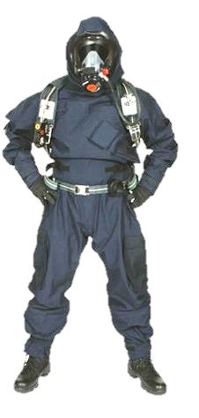
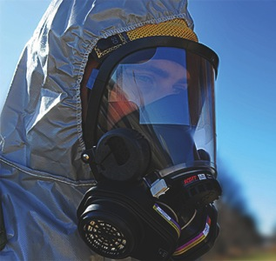
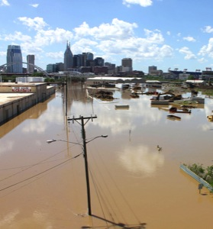
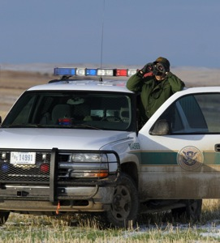
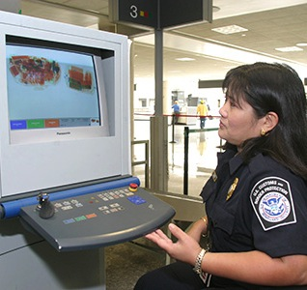
Apex Programs
 | Border Situational Awareness |  | Next-Generation First Responder
 | Real-Time Bio Threat Awareness |  | Next-Generation Cyber Infrastructure
 | Screening |  | Flood Awareness

Slide 6
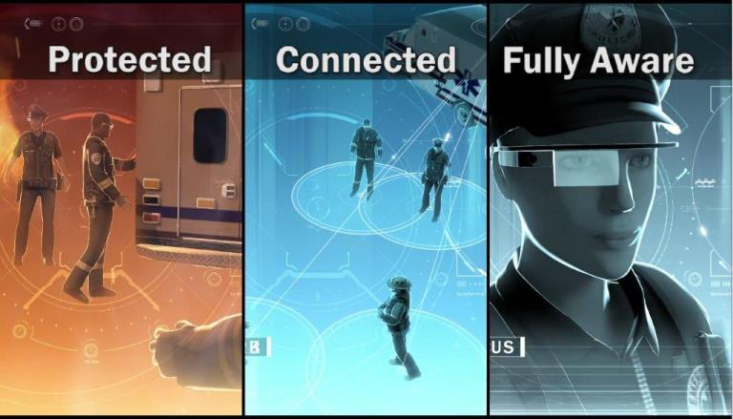
Next Generation First Responder (NGFR)

Slide 7
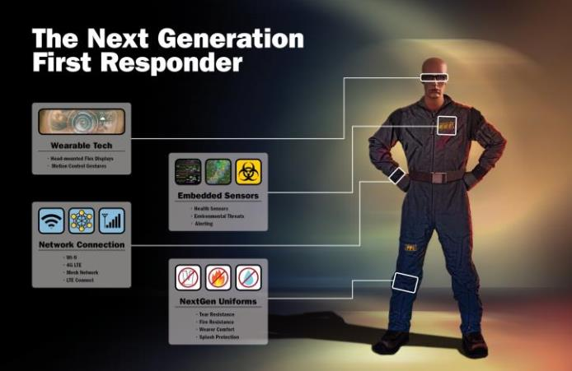
NGFR Major Components

Slide 8
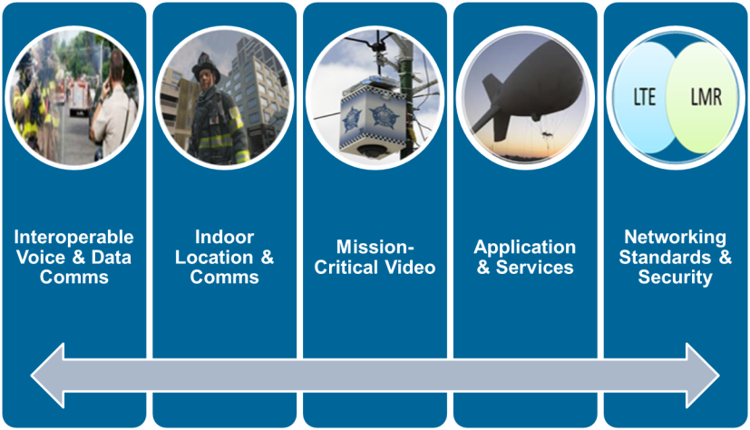
Communication & Networking Engine (CNET)
Apex CNET Engine

Slide 9
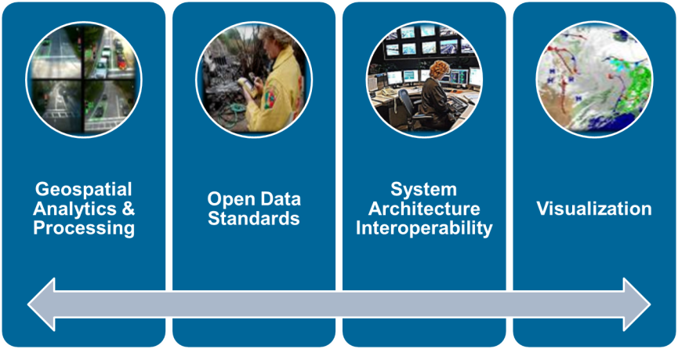
Situational Awareness/Decision Support (SANDS)
Apex SANDS Engine

Slide 10
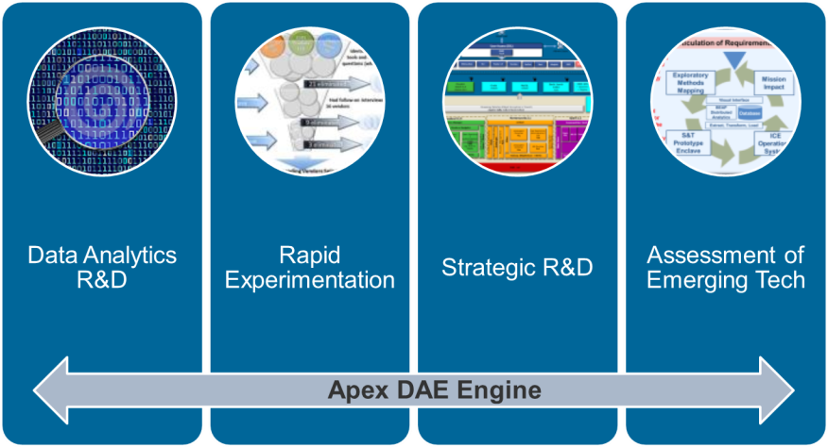
Data Analytics Engine (DAE)

Slide 11
EMERGE! Accelerator Program
Description
Intense training program for early-stage companies
Aimed at innovators in industrial and consumer markets whose wearable technology could be adapted for first responder operations
First program is EMERGE! on wearable technologies, such as body-worn electronics, advanced sensors and integrated voice and data communications embedded in responder’s gear
Value
Helps innovators develop and launch ideas into investable companies by providing early market validation, mentoring and access to private investment
Accelerates development of commercial wearable technologies and provides path to introduce those technologies to variety of markets

Slide 12
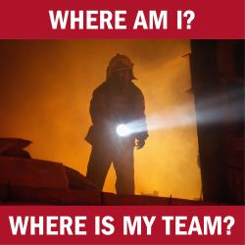
NGFR Prize Competition
Indoor Tracking of the Next Generation First Responder
Focuses on finding solutions for real-time, robust indoor tracking of first responders to answer the questions:
“Where am I?”
“Where is my team?”
Solvers required to tackle the “z” challenge
Submissions under review

Slide 13
NGFR Near-Term Objectives
Objectives: | FY 2015 | FY 2016
Real-time Situational Awareness | Develop baseline requirements, assess technologies, define an architecture and build a technology roadmap | Demonstrate Wearable technology / Mobile Ad Hoc Networking / Long Term Evolution Prototype
Duty Uniforms and Personal Protective Equipment (PPE) | Define performance criteria and identify operational, testing and evaluation requirements for duty uniforms and PPE | Produce 150 “America's Missing: Broadcast Emergency Response” prototype garment ensembles for DHS
Responder Technology Alliance | Develop Responder of the Future: Industrial Visionary Design | Develop systems-engineered solution management plans and launch responder technology accelerators
FY15 FY16 FY17 FY18 FY19 FY20
Incremental delivery of capabilities over program lifecycle
First responder Operational Test and Evaluation
Commercial transition and integration

Slide 14
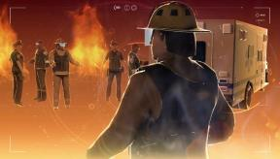
NGFR Performance Metrics
By 2020, first responders:
Adopt FRG-transitioned, commercialized cross-functional wearable uniforms that provide for effective environmental and mission specific safeguards.
Adopt FRG-transitioned, commercialized interoperable communications technologies that are seamlessly connected to enhance voice, video and data for all public safety agencies as well as state, local and federal partners.
Can visualize a situation in real-time before, during, and after a mission response including blue force tracking, locations of local and cross jurisdictional resources and any threats of immediate concern.

Slide 15
Incident Management Information Sharing Subcommittee (IMIS SC)
Information Sharing and Access Interagency Policy Committee (ISA IPC)
IMIS-SC
Co-Chair: Dr. Robert Griffin (DHS Science &Technology)
Co-Chair: Chief Charles Werner (National Information Sharing Consortium)
Subcommittee Members
Provide strategic direction, guide project initiatives and leverage professional networks to operate and maintain information sharing capabilities and capacity across the Public Safety community.
Use Case / Requirements
Working Group
Future State
Working Group

Slide 16
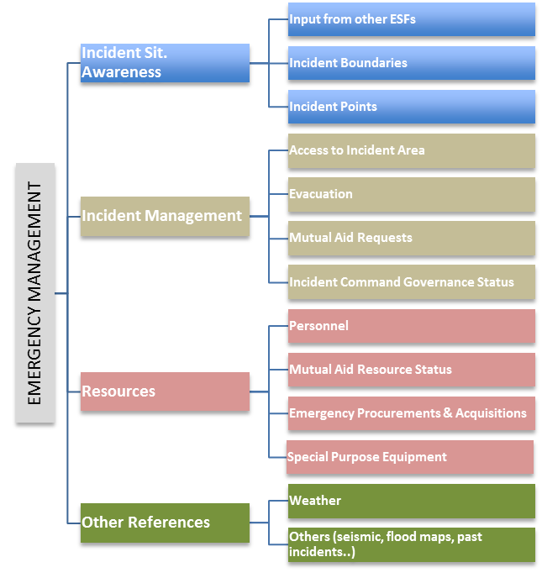
Essential Elements of Information (EEIs)
Goal: Expedite the institutionalization of consistent, well-defined, sharable, digitally-sourced EEIs for emergency response at the national, state and local levels
Four-part framework for arraying EEIs across the emergency support functions

Slide 17
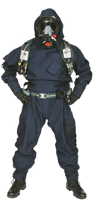
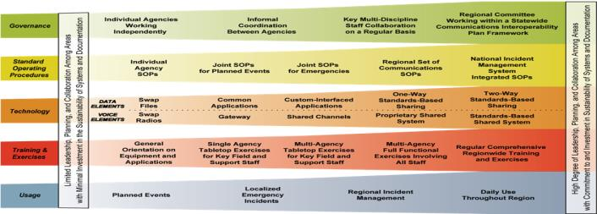
Continuum & Maturity Model Alignment
As-Is
To-Be
Define Need… Assess Landscape… Develop Solution… Deliver to Community…

Slide 18
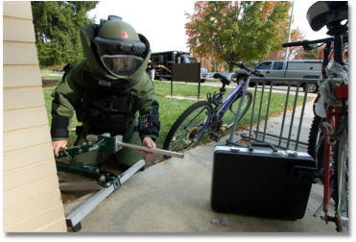
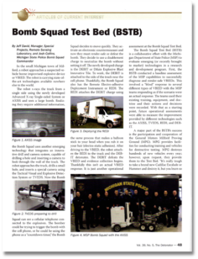
Response & Defeat Operations Support (REDOPS)
State & Local Bomb Squad (SLBS) Support
Develops new capabilities and performance requirements
Facilitates enhanced training standards to help protect and save lives (bomb techs, public)
Provide SLBSs with technology and tools to perform activities associated with response and defeat operations

Slide 19
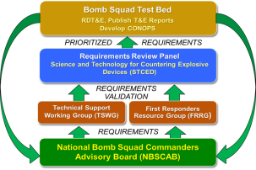
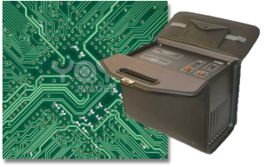
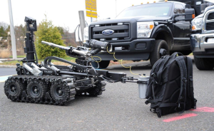
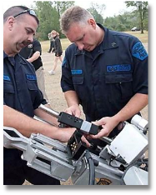
REDOPS Thrust Areas
Roadmap Development
Electronic Counter Measures
Research & Development
Testing & Evaluation

Slide 20
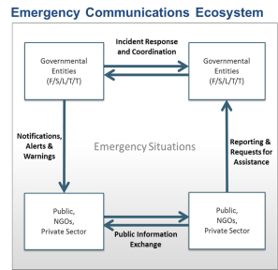
OIC / OEC Collaboration
Responders First
Complementary work and collaboration
Ongoing organizational information sharing

Slide 21
Engage With Us
NATIONAL
CONVERSATION
WEBSITES
scitech.dhs.gov
firstresponder.gov
SOCIAL MEDIA
STAKEHOLDER
ENGAGEMENT
PRIZE
AUTHORITY

Slide 22
JOIN THE CONVERSATION.
BE THE FUTURE OF R&D.
http://scitech.dhs.gov
START TALKING
TODAY!

