Slide 1
NPSTC Discusses Public Safety Telecommunications Current Events
APCO, International Annual Conference Washington, DC
August 17 and 18, 2015

Slide 2
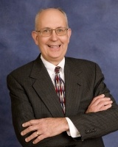
Welcome Ralph Haller, NPSTC Chairman

Slide 3
NPSTC Mission Statement
NPSTC is a federation of organizations whose mission is to improve public safety communications and interoperability through collaborative leadership.

Slide 4
NPSTC Governing Board (Voting Member Organizations)

Slide 5
NPSTC Structure
Governing Board
Spectrum Management Committee
Interoperability
Committee
Technology and Broadband
Committee
Each Committee hosts various working groups and task groups
NPSTC Relies on Volunteers

Slide 6
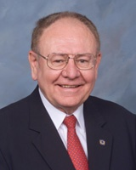
NPSTC Reviews Current Activities Nationwide Public Safety Broadband Network Harlin McEwen, NPSTC Governing Board Member
Notes:
6

Slide 7
Harlin R. McEwen
Chief of Police (Ret) - City of Ithaca, NY
FBI Deputy Assistant Director (Ret) - Washington, DC
chiefhrm@pubsaf.com 607-227-1664
Chairman, Communications & Technology Committee
Life Member and Honorary President
International Association of Chiefs of Police (IACP)
Life Member and Communications Advisor
National Sheriffs’ Association (NSA)
Life Member & Member Broadband Committee
APCO International
Chairman, Public Safety Advisory Committee (PSAC) First Responder Network Authority (FirstNet)

Slide 8
Public Safety Advisory Committee (PSAC)
Current Assignments
Priority and Preemption Task Team (Kicked Off 2/26/15)
Task Team Chair – Barry Fraser
FirstNet is seeking advice from the PSAC regarding an initial framework for implementing access prioritization, user preemption, and prioritized application use in the NPSBN.
Public Safety Grade Task Team (Kicked Off 2/27/15)
Task Team Chair – Captain Chris Lombard
FirstNet is seeking advice from PSAC regarding an initial methodology and framework for prioritizing and implementing NPSTC’s public safety grade recommendations in the NPSBN.
User Equipment Tasking, PSAC Executive Committee, (Kicked Off 3/4/15)
Task Team Chair – Chief Harlin McEwen
FirstNet is seeking advice from PSAC on functional objectives for and ergonomic considerations of Band 14 broadband user equipment that will meet the operational needs of first responders.
Notes:
8
8

Slide 9
Public Safety Advisory Committee (PSAC)
Future PSAC Activity
PSAC Webinar Meeting
Tuesday, September 22, 2015
PSAC Executive Committee Meeting
Wednesday, September 30, 2015 FirstNet Headquarters-Reston, VA)
PSAC In-Person Meeting
Wednesday, December 9, 2015, 1:00 pm – 5:00 pm, Houston, TX
Open to the Public
Thursday, December 10, 2015, 8:00 am – 12:00 pm, Houston TX
Closed to members only
Notes:
9
9

Slide 10
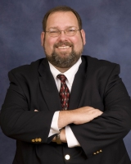
Technology and Broadband Committee Update Tom Sorley, Chair
700 MHz

Slide 11
Technology and Broadband Committee
Priority & Quality of Service (PQoS) Report
Addresses public safety requirements and makes recommendations on implementation of a priority framework by FirstNet.
Report approved August 15, 2015

Slide 12
Technology and Broadband Committee
Local Control in the Nationwide Public Safety Broadband Network (NPSBN)
Addresses public safety requirements for local control
Expect to finalize report in September 2015
Report on NG911 and the NPSBN
Addresses high level functionality of both systems
Published by NPSTC on June 23, 2015
Broadband Deployable Systems
Bi-National Working Group with U.S. and Canada examining all deployable system types.

Slide 13
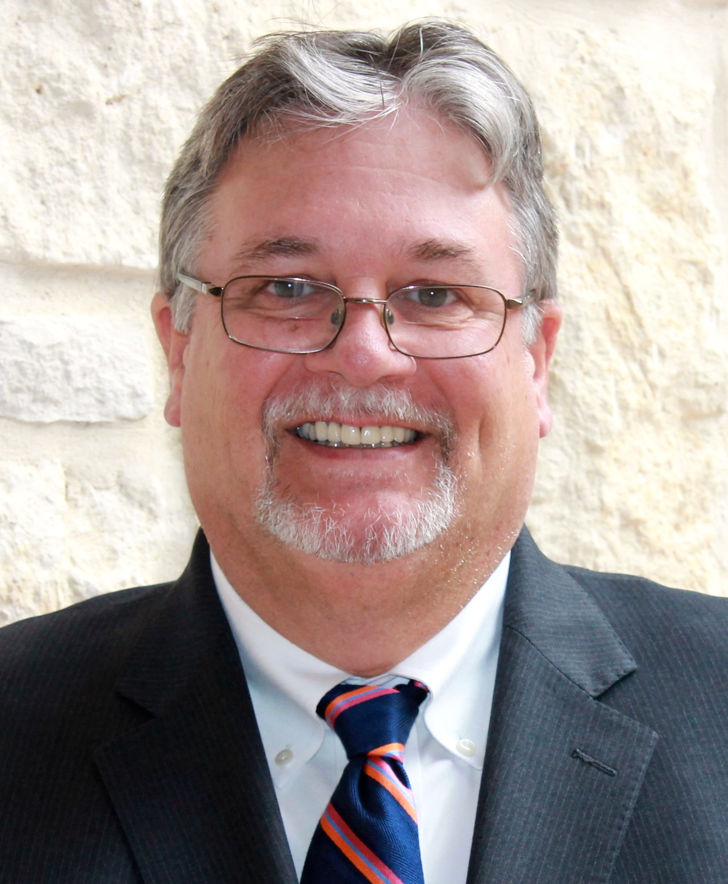
Current Spectrum Issues Stu Overby, Spectrum Management Committee Vice-Chair
Notes:
13

Slide 14
Current Spectrum Issues
NPSTC Report finalized June 30, 2015
NPSTC recommends FCC pay additional attention to this issue
The goal should be to prevent interference rather than having to resolve it after the fact.

Slide 15
Current Spectrum Issues
700 MHz Band Deployable Trunked Systems
FCC approved six 12.5 kHz channels from reserve spectrum
NPSTC report out soon regarding spectrum and radio ID logistics
FCC Oct. 31, 2015 deadline for RPCs to add channels to plans
4.9 GHz
NPSTC National Plan Recommendation Oct. 2013
NPSTC participating in APCO study initiative
800 MHz Interstitials
NPSTC supports LMCC recommended plan

Slide 16
Current Spectrum Issues
Filings Completed YTD in 2015 (page 1 of 2):
Date Filed | Topic | Type of Filing
July 29 | LightSquared/GPS | Letter to FCC
July 27 | FirstNet Draft RFP | Comments to FirstNet
July 13 | Interference Dispute Resolution | Comments to FCC
July 6 | Rules on Public Safety Airborne Use | Ex Parte to FCC
July 1 | AT&T Waiver Request - Kansas | Comments to FCC
July 1 | RF Interference from Lighting | Letter/Report to FCC
June 19 | Waiver Request-Ultra Wideband | Comments to FCC
June 4 | FirstNet Third Notice re PS Definition | Comments to FirstNet
June 8 | 800 MHz band Interstitials | Ex Parte to FCC

Slide 17
Current Spectrum Issues
Filings Completed YTD in 2015 (page 2 of 2):
Date Filed | Topic | Type of Filing
May 28 | TIA Recon re P25 CAP at 700 MHz | Ex Parte to FCC
May 11 | 800 MHz Interstitials | Comments to FCC
April 30 | AT&T Waiver Request - Missouri | Comments to FCC
April 28 | FirstNet Second Notice re Opt-Out | Comments to FirstNet
February 17 | Public Safety Interoperability | Letter to GAO
February 23 | TIA Recon re P25 CAP at 700 MHz | Reply Comments to FCC
February 20 | Cellular Service Rules on Power | Reply Comments to FCC
February 13 | 700 MHz Deployable Channels | Letter w/NRPC to FCC
January 5 | Frequency Coordinator Certification | Comments to FCC

Slide 18
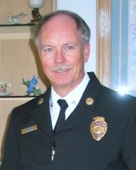
Interoperability Committee Update Battalion Chief John Lenihan, Chair

Slide 19
Interoperability Committee Update
Interoperability depends on human interaction and proper operational procedures, in addition to technology and spectrum.

Slide 20
Interoperability Committee Update
Channel Naming
Revised ANSI standard recommendations sent to APCO, including 700 MHz air-to-ground channels.
EMS Report
Completing Telemedicine video report based on nationwide questionnaire.
Cross Border
Outreach recommendations on portable use at the border being finalized.
Radio Interoperability Best Practices
Added a new Best Practice on encryption.
700 MHz Deployable Operations

Slide 21
Conclusion
How Can You Become Involved?
Visit the NPSTC Booth: #509
Check out the NPSTC website: www.NPSTC.org
Sign up to participate in NPSTC committees/working groups/task groups
Questions??
Presentation of the DJ Atkinson Technical Award

Slide 22
Thank you!
www.npstc.org
1- 866 - 807- 4755

