Slide 1
Public Safety Related Spectrum Issues in the 902-928 MHz Band
The Part 15 Coalition
Henry Goldberg
Laura Stefani
May 15, 2013
Notes:
Background on Coalition
FCC spectrum decisions are always “he said, she said”

Slide 2
Part 15 Coalition Members
Alarm Industry Communications Committee
American Petroleum Institute
Association of American Railroads
Elster Solutions
FreeWave Technologies, Inc.
GE Digital Energy
Inovonics Wireless Corporation
Intelleflex Corporation
Itron, Inc.
Landi+Gyr Company
MJ Lynch & Associates LLC
Notor Research
Plantronics
Qualcomm Incorporated
Silver Spring Networks
Starkey Laboratories, Inc.
Utilities Telecom Council
Wireless Internet Service Providers Association

Slide 3
Part 15 Coalition Supporters
Cisco
E-Z Pass Group
Google Inc.
IEEE 802.11
Kapsch TrafficCom IVHS, Inc.
Microsoft Corporation
New America Foundation
Public Knowledge

Slide 4
The 902-928 MHz Band
Federal Government - Radiolocation
Industrial, Scientific and Medical (ISM) FCC Part 18
Federal Government - non-Military Radiolocation, Fixed and Mobile
Progeny’s licenses
M-LMS
Non
M-LMS
M-LMS
Non
M-LMS
M-LMS
Beacon
Beacon
902
904
909.75
919.75
921.75
927.25
928
Amateur Radio
Unlicensed FCC Part 15
902 MHz
928 MHz

Slide 5
25+ Years of Unlicensed Use
The 902-928 MHz unlicensed band provides enormous societal and economic benefits, fully justifying the FCC’s confidence almost 20 years ago in providing protection from unacceptable interference.
If anything, the band is more important today than when it was first extended protection by the Commission. It’s equal or greater in importance than the 2.4 GHz “WiFi” band.

Slide 6
The Coalition’s Position
The Coalition fully supports the CSRIC Report’s suggestion to the FCC that further testing and study of E911 location systems takes place.
Progeny/NextNav ‘s technology is a work in progress; the CSRIC Report states that Progeny will need at least a 2nd generation system, since the present system does not meet public safety’s needs.
While the Progeny/NextNav system is being developed, the FCC should not allow the company to operate a system that causes unacceptable interference to Part 15.

Slide 7
The Installed Base – Hundreds of Millions of Unlicensed Devices on 902-928 MHz
100’s of millions of smart grid devices, with life-spans up to 20 years.
10’s of millions of oil and gas monitoring devices.
10 million emergency duress and alarm devices.
100’s of millions of other industrial and consumer devices.
Hundreds of new equipment authorization grants each year.

Slide 8
Life-Safety Related Unlicensed Use of the 902-928 MHz Band

Slide 9
Utilities have installed hundreds of millions of unlicensed devices used to manage the grid, including identifying and responding to gas leaks and other emergencies.
Chemical, oil and gas, and pipeline companies rely upon tens of millions of devices used to monitor facilities and perform remote shut off in the event of any leaks or other disasters.
Wireless broadband providers use the spectrum to provide internet service to unserved and underserved communities across the country, including to police and fire departments.

Slide 10
Inovonics, a manufacturer of duress and alarm systems, has ten million devices installed throughout the United States at facilities such as schools, theaters, banks, hospitals, and state/local/federal government buildings, including systems that provide location-based information to first responders responding to a duress call.
EZPass, which is used in sixteen states for toll services and traffic management services, provides for the flow of traffic via bridges and tunnels in major urban areas.

Slide 11
A Unique Unlicensed Band
FCC’s special protections:
1. M-LMS (Progeny’s) License Condition: “the licensee’s ability to demonstrate through actual field tests that their systems do not cause unacceptable levels of interference to Part 15 devices.” 47 C.F.R. § 90.353(d).
2. Safe harbor: Unlicensed users conforming to specified technical conditions are insulated from claims that such devices cause harmful interference to M-LMS systems. 47 C.F.R. § 90.361.

Slide 12
The Problem: Progeny’s Waiver
FCC waived Section 90.353(g) so Progeny can track the location of both vehicular and non-vehicular mobile devices on an “equally available” basis.
Indoor location finding service requires more density: Sensors receiving signals from at least 3 beacons indoors, and 8 of 10 time slots used outdoors in dense (urban) areas, which means an 80-100% duty cycle.
Notes:
The Progeny system requires that a sensor receive signals from 3 or more beacons; for accuracy, in dense urban areas more beacons are needed to ensure its location is found; thus, the Progeny system is designed to be synchronized so that up to 8 of 10 time slots receive beacon signals one after the other, so that 80% of the time there is a beacon firing.

Slide 13
Progeny’s Burden
Under the Commission’s rules, Progeny has the burden of demonstrating that it will not cause unacceptable levels of interference.
Looking at test results and occurrences of interference, it has not met that burden.

Slide 14
Progeny Test Results
Testing shows that there will be interference from Progeny operations because of duty cycle, power, & density of transmitters.
For some Part 15 users, Progeny will preclude co-frequency operation on Progeny’s 4 MHz of spectrum (15% of the band).
For other wideband Part 15 users, Progeny will preclude operation on much more of the 902-928 MHz band (about 2/3 of the band).

Slide 15
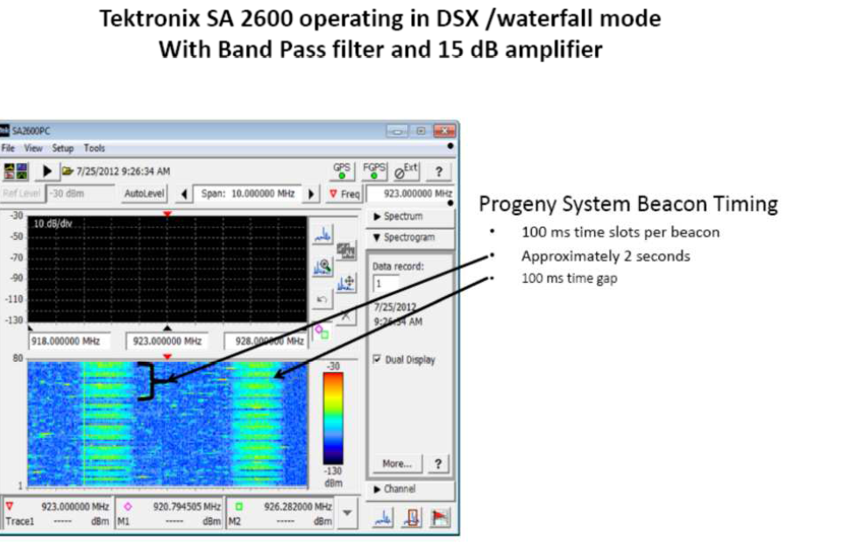
Preclusive effect of Progeny’s duty cycle
Notes:
The green color indicates when the Progeny system is on, and supports to our position that they use a 80% duty cycle.

Slide 16
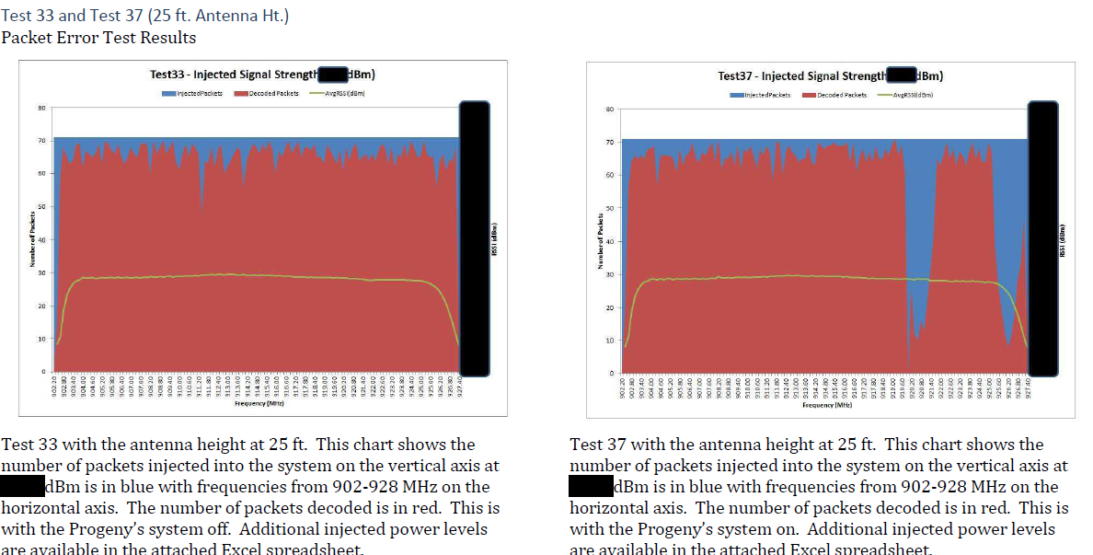
Notes:
Here is one of the many tests conducted between Itron and Progeny, which shows on the left a large amount (80%) of Progeny’s frequencies taken over by the Progeny signal; on the right is with the Progeny system off – in this snapshot, there is some unlicensed use but much of the band is free. Even at times when a channel is busy with an unlicensed device, because of the Part 15 rules that balance power, duty cycle, bandwidth and frequency use, that channel will stay busy for a short time, whereas Progeny is on 80% of the time, a brickwall.

Slide 17
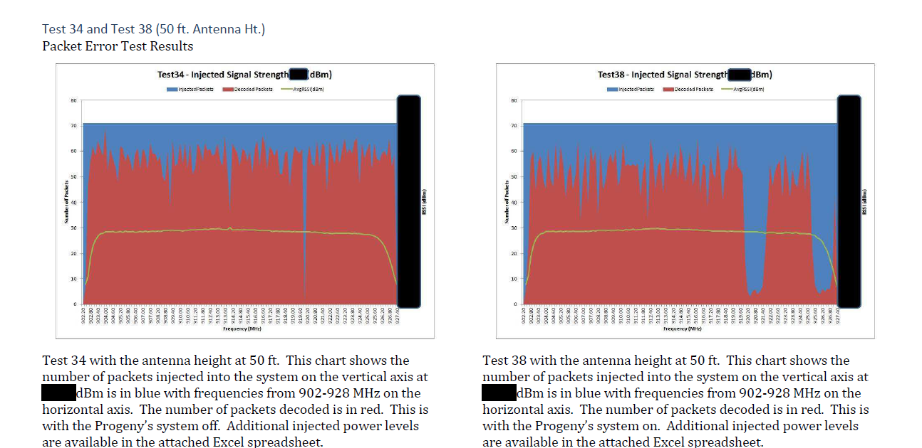

Slide 18
Evidence of Actual Interference from Progeny
-Plantronics received notifications of interference from users in the Bay Area.
-Taggle Systems could not operate its smart grid system in the Bay Area due to the presence of Progeny transmitters.
-A major utility experienced interference from Progeny’s transmissions.

Slide 19
Progeny construction in other 39 markets is minimal
Evidence of only 1 beacon transmitting within a 10-15 mile radius.
While unlicensed users could co-exist with such “operations”, it is far less than what would be required for a functional, 2nd generation E911 indoor location system.

Slide 20
Additional Testing & System Modifications Needed
The FCC stated in Progeny’s waiver: “If [] significant interference concerns are raised, [FCC] will determine what additional steps may be appropriate.”
Now is the time to consider those additional steps.
The FCC must require and monitor additional testing of Progeny’s system with a wide variety of Part 15 devices; testing has been requested of Progeny by many parties, with no response.
The FCC must consider modifications to Progeny’s system design to make it compatible with unlicensed technologies and services.

Slide 21
E911 Location Services
The Part 15 Coalition fully appreciates and supports the need for improved wireless E911 location accuracy.
As CSRIC testing showed, Progeny, like others, is a nascent indoor location technology that does not yet meet Public Safety’s needs.
There are many other technologies under development.

Slide 22
March 14, 2013 CSRIC Report
“even the best location technologies tested have not proven the ability to consistently identify the specific building and floor which represents the required performance to meet Public Safety's expressed needs. This is not likely to change over the next 12-24 months. Various technologies have projected improved performance in the future, but none of those claims have yet been proven through the test bed process. It is hoped that such technologies would be tested and validated in future test bed campaigns.” (pgs. 54-55)

Slide 23
Positioning Technology State of Affairs
There is no reliable, high-precision solution where mobile devices are used today
The missing piece....
Cell-ID
TruePosition and Inovonics Systems
Indoors
Wi-Fi
Urban
Canyon
Areas of Use
A-GPS + AFLT
GPS
Outdoors
5m
50m
500m
Accuracy
Notes:
Contrary to Progeny’s claims, it is not the only option for filling this void. True Position and Inovonics are two providers of location services that fill the same void as Progeny, are more accurate, and do not require additional spectrum.

Slide 24
Progeny Assumed the Risk
Progeny paid a little over $2M for the licenses.
The low price was due to the extensive Part 15 use of the band and the testing and other conditions placed on the licenses to protect Part 15 users.
Progeny understood this when they bought the licenses; they began construction prior to Part 15 testing at their own risk.

Slide 25
No Rush to Judgment
Given what’s at stake for unlicensed service, prudence rather than haste is warranted.

