Slide 1
NPSTC Presents Public Safety Communications Current Events
March 18, 2015
Moderators: Ralph Haller and Marilyn Ward
Panelist: Harlin McEwen, David Buchanan, Tom Sorley, and Andrew Thiessen
Notes:
1

Slide 2
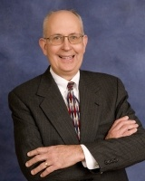
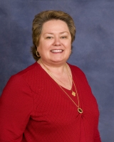
Welcome Ralph Haller, NPSTC Chairman and Marilyn Ward, Executive Director

Slide 3
NPSTC Mission Statement
NPSTC is a federation of organizations whose mission is to improve public safety communications and interoperability through collaborative leadership.

Slide 4
NPSTC Governing Board Organizations

Slide 5
NPSTC Organizations (continued)
Associate Organizations
Canadian Interoperability Technology Interest Group
Utilities Telecom Council
Affiliate Organizations
Alliance for Telecommunications Industry Solutions
Open Mobile Alliance
Telecommunications Industry Association
TETRA Critical Communications Association
Liaison Organizations
Federal Communications Commission
Federal Emergency Management Agency
Liaison Organizations (cont.)
Federal Partnership for Interoperable Communications
National Telecommunications and Information Administration
Office for Interoperability & Compatibility
Office of Emergency Communications
Public Safety Communication Europe
SAFECOM
U.S. Department of Justice
U.S. Department of the Interior

Slide 6
How is NPSTC organized?
Governing Board
Representatives from each of its member organizations
Executive Committee
Chair
Vice Chair and 2nd Vice Chair
Committee Chairs and Vice Chairs
Executive Director and Deputy Executive Director
Technical Committees
Interoperability Committee
Spectrum Management Committee
Technology and Broadband Committee
Notes:
6
6

Slide 7
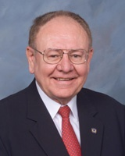
NPSTC Reviews Current Activities - Nationwide Public Safety Broadband Network Harlin McEwen, NPSTC Governing Board Member
Notes:
7

Slide 8
Harlin R. McEwen
Chief of Police (Ret) - City of Ithaca, NY
FBI Deputy Assistant Director (Ret) - Washington, DC
chiefhrm@pubsaf.com 607-227-1664
Chairman, Communications & Technology Committee
Life Member and Honorary President
International Association of Chiefs of Police (IACP)
Life Member and Communications Advisor
National Sheriffs’ Association (NSA)
Life Member & Member Broadband Committee
APCO International
Chairman, Public Safety Advisory Committee (PSAC) First Responder Network Authority (FirstNet)

Slide 9
Public Safety Advisory Committee (PSAC)
Current Assignments
Priority and Preemption Task Team (Kicked Off 2/26)
FirstNet is seeking advice from PSAC regarding an initial framework for implementing access prioritization, user preemption, and prioritized application use in the NPSBN
Public Safety Grade Task Team (Kicked Off 2/27)
FirstNet is seeking advice from PSAC regarding an initial methodology and framework for prioritizing and implementing NPSTC’s public safety grade recommendations in the NPSBN
User Equipment Tasking (Kicked Off 3/4)
FirstNet is seeking advice from PSAC on functional objectives for and ergonomic considerations of Band 14 broadband user equipment that will meet the operational needs of first responders
Notes:
9
9

Slide 10
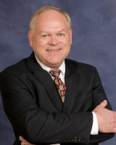
NPSTC Discusses Current Spectrum Issues David Buchanan, Spectrum Management Committee Chair
Notes:
10

Slide 11
Spectrum and Interoperability Topics
LED Lighting Interference Survey
700 MHz Deployable Trunked Channel designations
Common Channel Naming
EMS Video Project

Slide 12
NPSTC Filings Summary
Date | Filing | Topic
2/23/15 | Reply to Recon Request (FCC) | P25 CAP
2/20/15 | Reply Comments (FCC) | Cellular PFD/Minimizing Interference
2/13/15 | NPSTC/NRPC Letter (FCC) | 700 MHz Deployable Channels
1/5/2015 | Comments (FCC) | Public Safety Frequency Coordination
12/17/2014 | Comments (FCC) | Part 22 Rules
10/27/2014 | Comments (FirstNet) | FirstNet Public Safety User Definition
10/16/2014 | Ex Parte Comments (FCC) | 4.9 GHz National Plan Proposal
7/14/2014 | Reply Comments (FCC) | Wireless 9-1-1 Location Accuracy
6/30/2014 | Comments (FCC) | Part 90 Frequency Coordinators
5/16/2014 | Petition for Rule Making (FCC) | Railroad Police Access to PS I/O Channels
5/12/2014 | Comments (FCC) | Wireless 9-1-1 Location Accuracy
5/9/2014 | Ex Parte Comments (FCC) | 4.9 GHz National Plan Proposal
4/28/2014 | Ex Parte Comments (FCC) | 4.9 GHz National Plan Proposal

Slide 13
Anticipated NPSTC Filings
Date | Filing | Topic
4/13/2015 | Comments (FirstNet) | FirstNet Second Public Notice
4/17/2015 | Reply Comments (FCC) | 700 MHz Deployable Channels
TBD | Comments (FCC) | 800 MHz Interstitials
TBD | Letter (FCC) | LED Lighting Interference

Slide 14
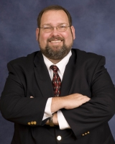
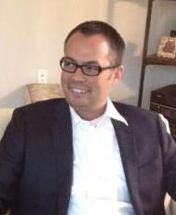
Technology and Broadband Committee Update Tom Sorley, Chair and Andy Thiessen, Vice Chair
Notes:
14

Slide 15
LTE Global Standards
Stage 1 Stage 2 Stage 3
Release 12
Proximity Services
Proximity Services
Proximity Services
Group Communications
Group Communications
Group Communications
Stage 1 Stage 2 Stage 3
Proximity Services
Proximity Services
Proximity Services
Release 13
Group Communications
Group Communications
Group Communications
MCPTT
MCPTT
MCPTT
Stage 1 Stage 2 Stage 3
Release 14
MCVideo
MCVideo
MCVideo
Stage Completed
Stage In Progress
Stage Not Started

Slide 16
Broadband
Priority & QoS Working Group
Local Control Working Group
Deployable Systems Working Group

Slide 17
Technology
FirstNet/NG9-1-1 Outreach
Radio Programming and Compatibility Requirements (Radio PCR)
Video Technology Advisory Group (VTAG)

Slide 18
Questions/Comments?

Slide 19
Thank you!
Please join NPSTC at our Meeting Friday, March 20, 2015 in Room N258 at 8:30 a.m.
Booth 772
www.npstc.org

