Slide 1
TIA Update NPSTC
Chris Lougee
Chair, Private Radio Section (PRS)
Telecommunications Industry Association
Vice President
Icom America, Inc.

Slide 2
Who is TIA?
Trade association
Global information and communications technology (ICT) industry
Standards development
Policy initiatives
Business opportunities
Market intelligence
Networking events.
Hundreds of members

Slide 3
TIA “Policy”
Participate in policy decisions
Impact the communications industry
Regulatory issues
Affect member companies
Events, Publications and Filings
Committees and Working Groups
Wireless Communications Division (WCD)
Private Radio Section (PRS)

Slide 4
TIA “Technology & Standards”
Accredited by the American National Standards Institute (ANSI)
Develop voluntary, consensus-based industry standards
12 engineering committees
TR-8 “Mobile and Personal Private Radio Standards”
Formulation of TIA-102 Series standards for Project 25

Slide 5
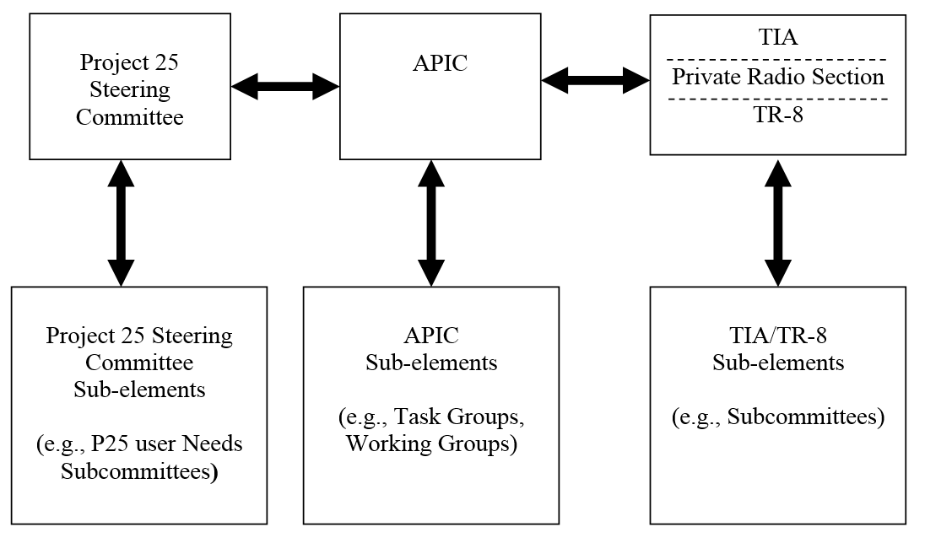
“Standards” and “Policy” Working Together
Jim Downes
P25SC Chair
DHS, OEC
George Crouch
P25 SC Vice Chair
NASTD
State of SC
Julio Laguardia
UNS Chair
DOJ
Paul Gilbert
UNS Vice Chair
TX DOT
State of TX
Brandon Diemer
APIC Chair
BLM
Chris Lougee Andy Davis
PRS Chair TR8 Chair
Icom America, Inc. Motorola Solutions, Inc.

Slide 6
P25 User Needs Subcommittee (UNS)
Provides input to P25 Steering Committee
Recommends Priorities of SOR content for consideration for standardization
Gathers input from a variety of sources
Consideration for inclusion in the SOR
P25 Statement of Requirements (SOR)
Equipment functionality critical for Public Safety
P25 Steering Committee sends SOR priorities to APIC
Membership open to users

Slide 7
APCO Project 25 Interface Committee (“APIC”)
Provides technical assistance to P25 and TIA
Formulating, and preparing documentation for the Project 25 Standard.
Recommendations to clarify or improve standards requirements
Address needs of the public safety communications community
Technology studies
Reviews operational requirements (SOR)
Technology tests
Draft technical concept papers.
“All volunteer” organization
Open to any organization, or individual, with an interest in developing P25 standards
Wider and more diverse forum of interested participants than P25/TR8 members
Not a standards formulating body
Ad hoc committee of the TIA Private Radio Section
Join in … become a part of the P25 Standards Development process!!

Slide 8
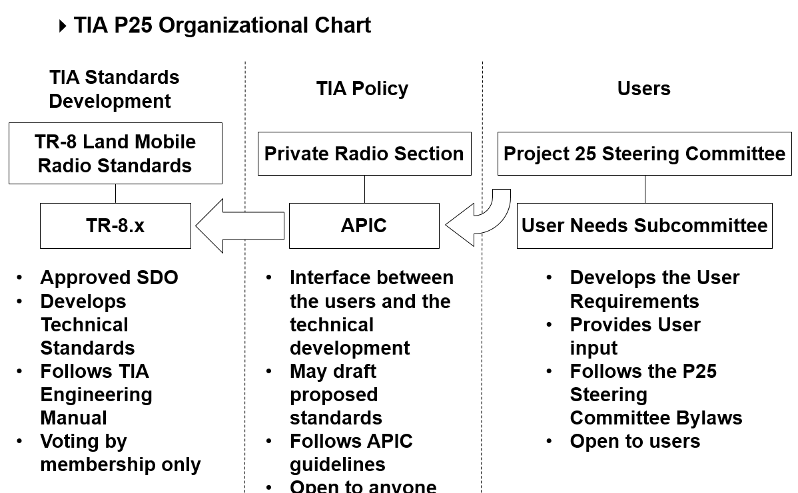

Slide 10
TIA initiated (not P25 SOR based)

Slide 11
Current Activities
Standards
New standards
Standards in process
Steve Nichols, Director, PTIG
Policy
CAP Process
700 MHz Deployable Trunked Channels
700 MHz Petition to Reconsider

Slide 12
Contact Information
Chris Lougee
Chair, Private Radio Section (PRS)
Vice President, Icom America, Inc.
425-450-6073
chrislougee@icomamerica.com

